Slide 1
Utilization of Simulated UAS Imagery to Assess the Accuracy of Structure from Motion Algorithms for Bathymetric Mapping
Structure from Motion and Multi-view Stereo algorithms have shown success in generating pointcloud data of bathymetry when imaged from unmanned aircraft systems (UAS) using various processing approaches. A basic approach to processing these data utilizes commercial structure from motion (SfM) software that does not account for refraction at the water surface. Errors introduced by this omission propagate into the resultant pointcloud, and measured water depths are predominantly too shallow. Methods ranging from submerged ground control targets to post-processing scale factors have been implemented to correct for these errors. Here, a simulated image rendering workflow (simUAS) is utilized to simulate different experiments that include water refraction and surface waves wherein images are generated along a simulated UAS flight path. These data are processed using commercial software and various processing methodologies, and the output pointclouds are compared to the control model data. The pointcloud error is quantified for various scenarios to determine the effect of camera, flight, and processing parameters on the accuracy of the resultant pointcloud. Lessons learned from the experiments are presented and compared to preliminary results from a real world field experiment.

Slide 2
Utilization of Simulated UAS Imagery to Assess the Accuracy of Structure from Motion Algorithms for Bathymetric Mapping
Richie Slocum
Tim Battista
Brian Costa
Christopher Parrish
Wayne Wright

Slide 3
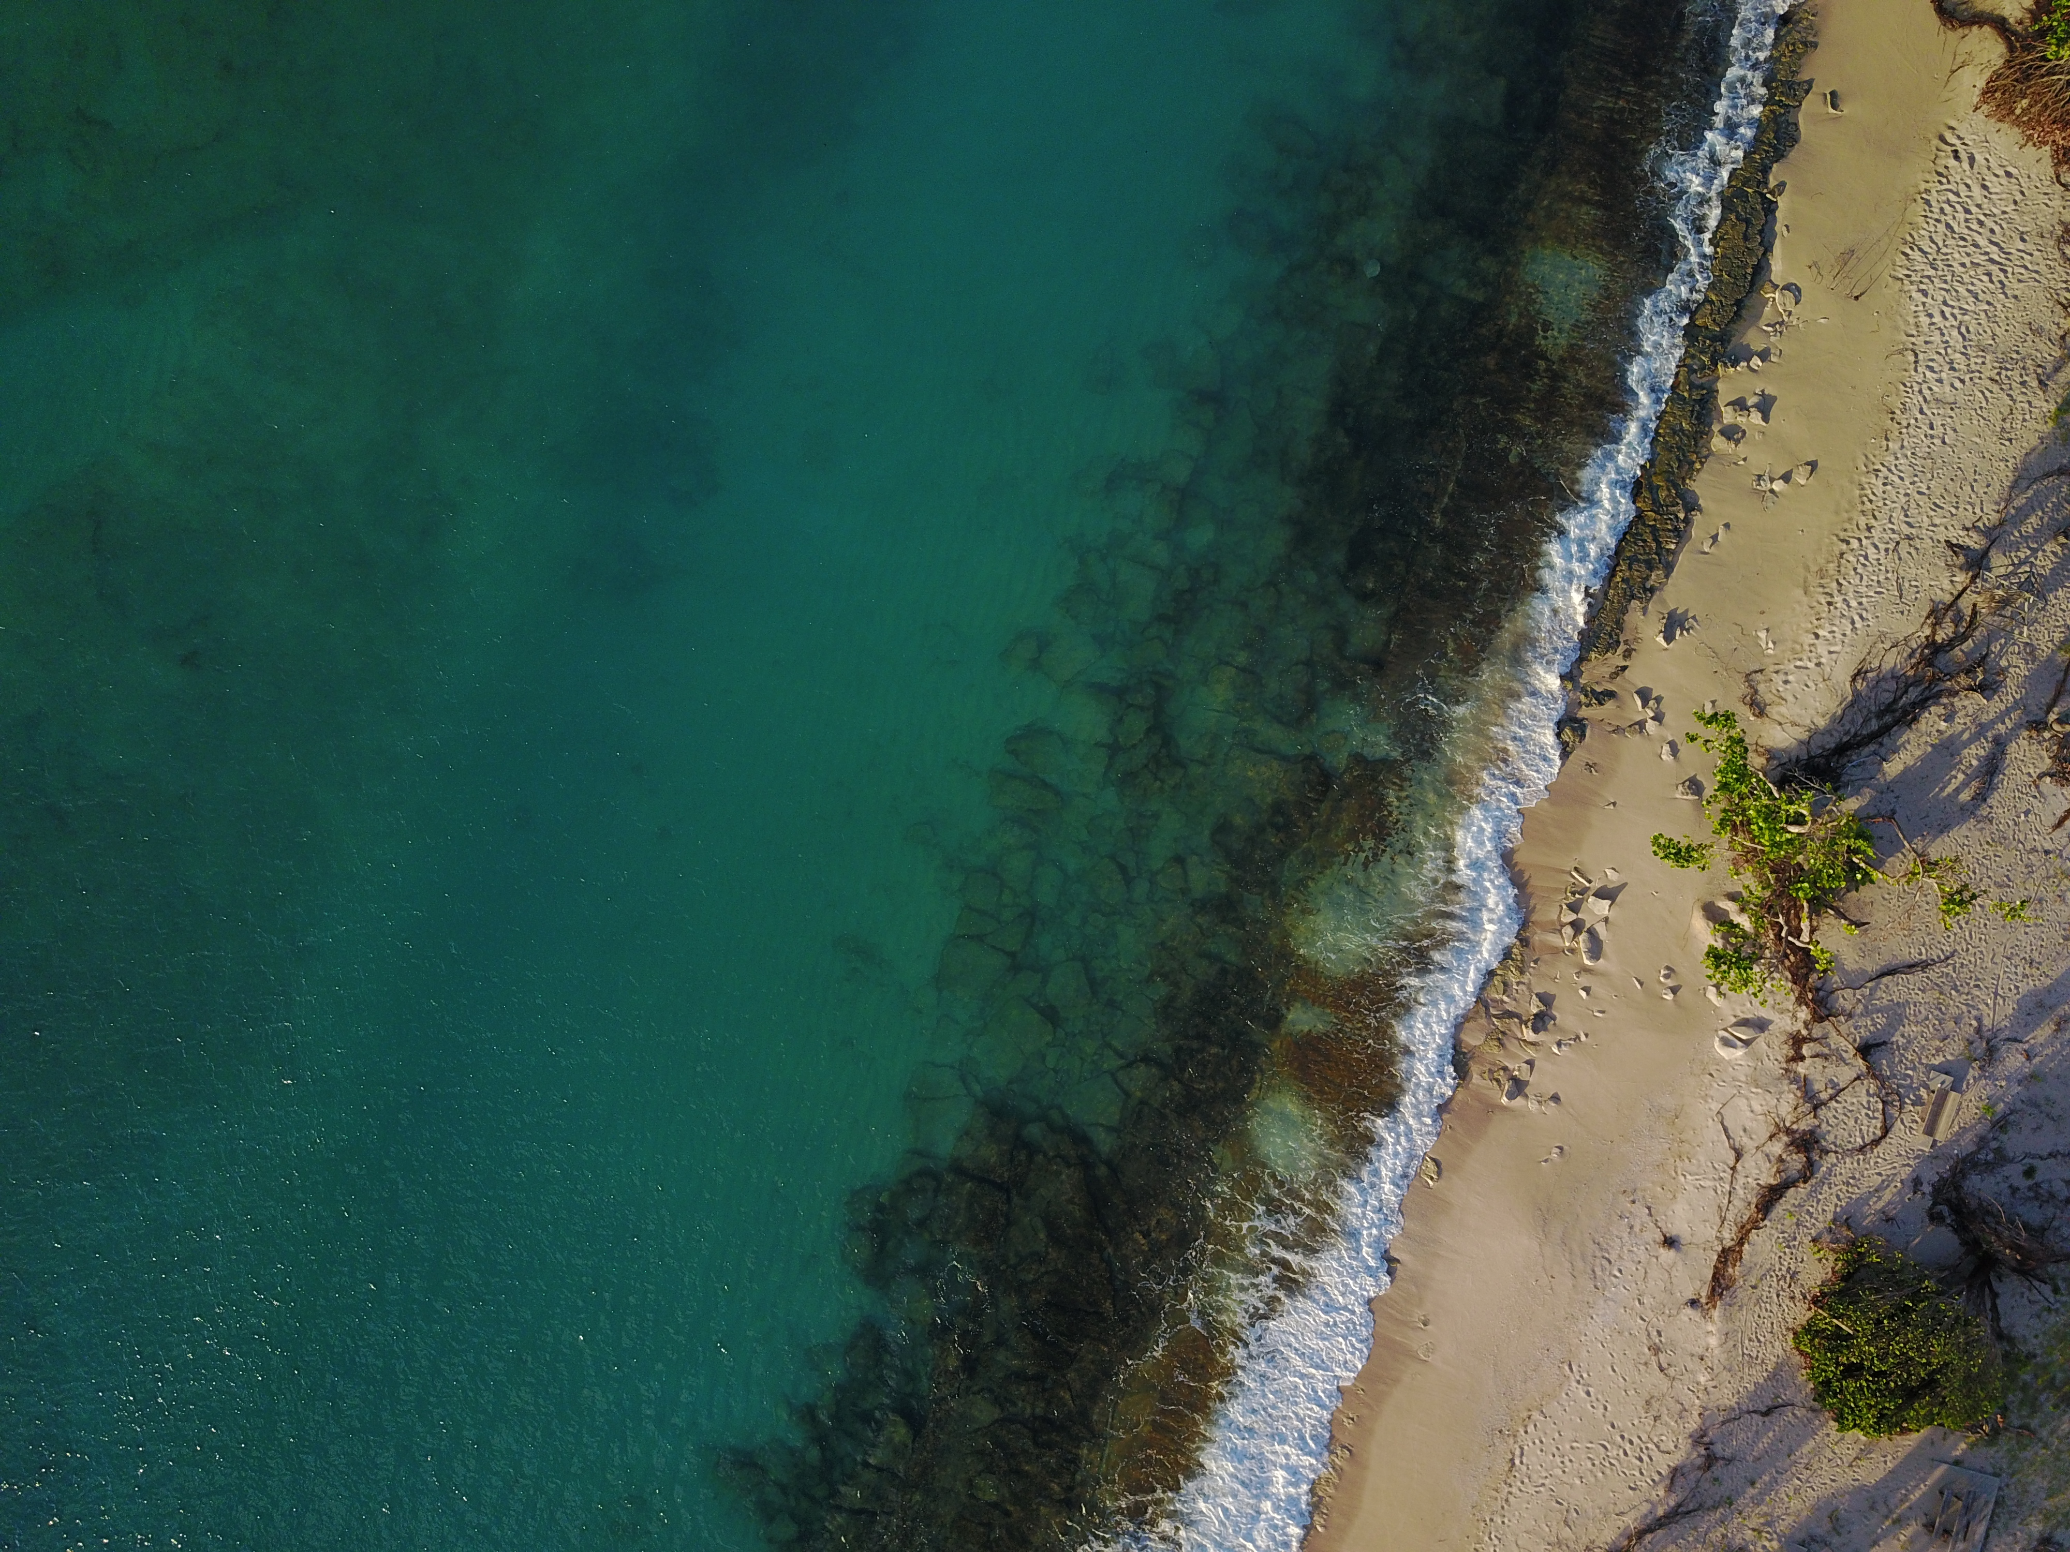
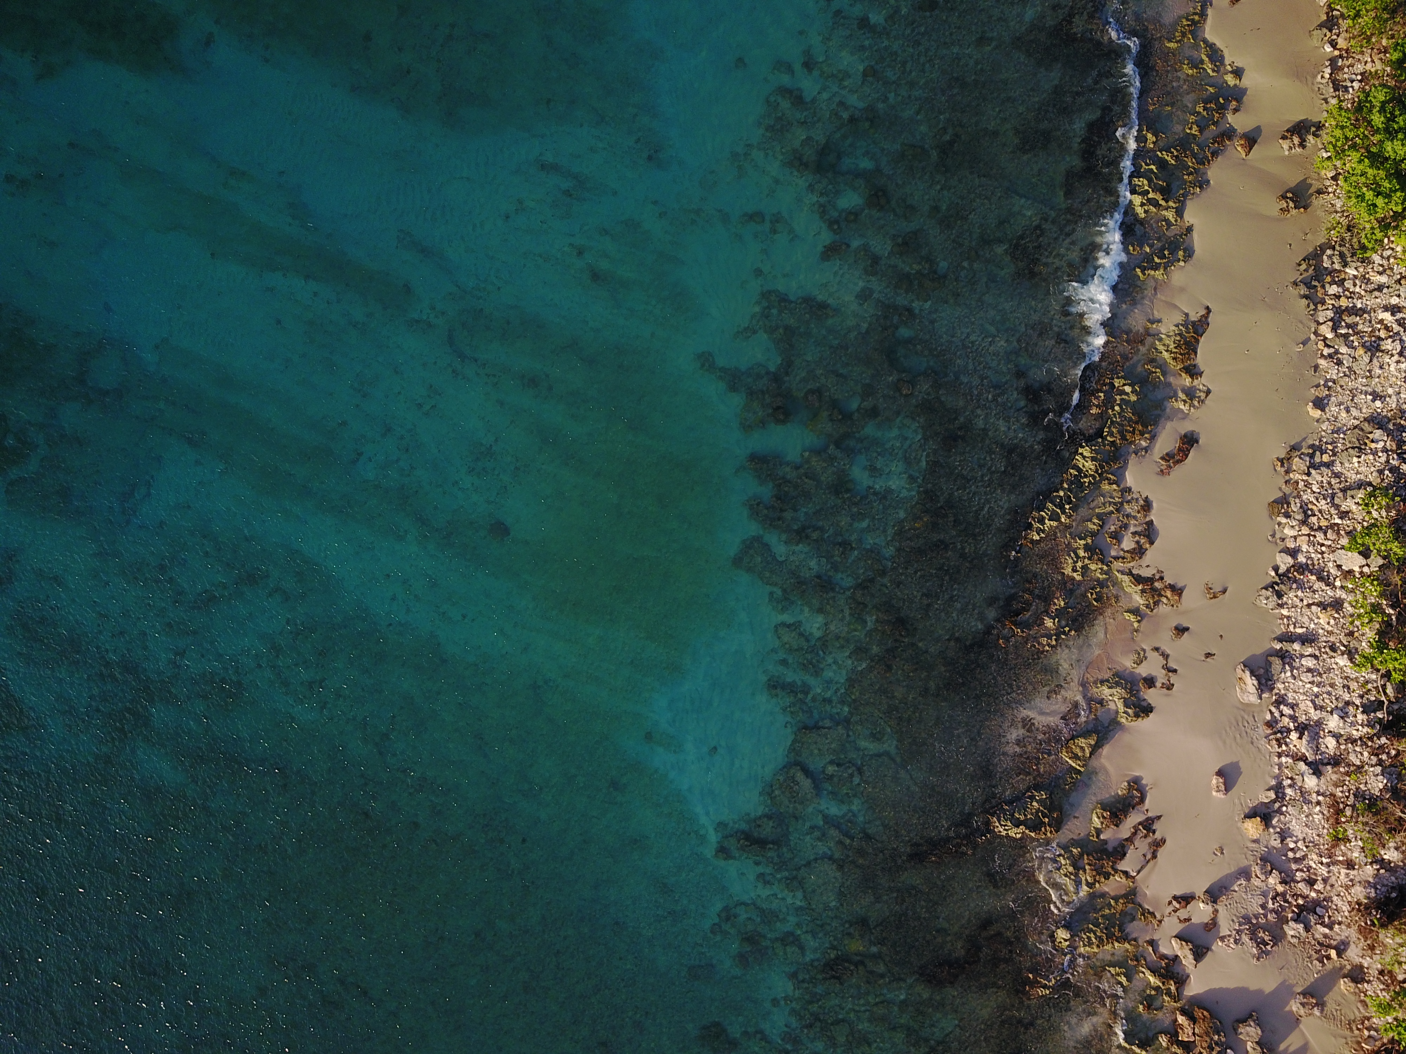
Outline
Structure from Motion(SfM) Overview
Bathymetric Structure from Motion Challenges
Methodology to Simulate UAS flights (simUAS)
Simulation Results

Slide 4
Structure from Motion
Image based pointcloud generation
Nonlinear Optimization: Place cameras and keypoints to minimize reprojection error
Assumption: No refraction!
and
or
* Need at least 1 for real world coordinates

Slide 5
Structure from Motion
Camera 1
Camera 2
True Location

Slide 6
Bathymetric Structure from Motion
Refraction Induced Error
Camera 1
Camera 2
Water IOR = 1.33
Perceived Location
Error
True Location

Slide 7
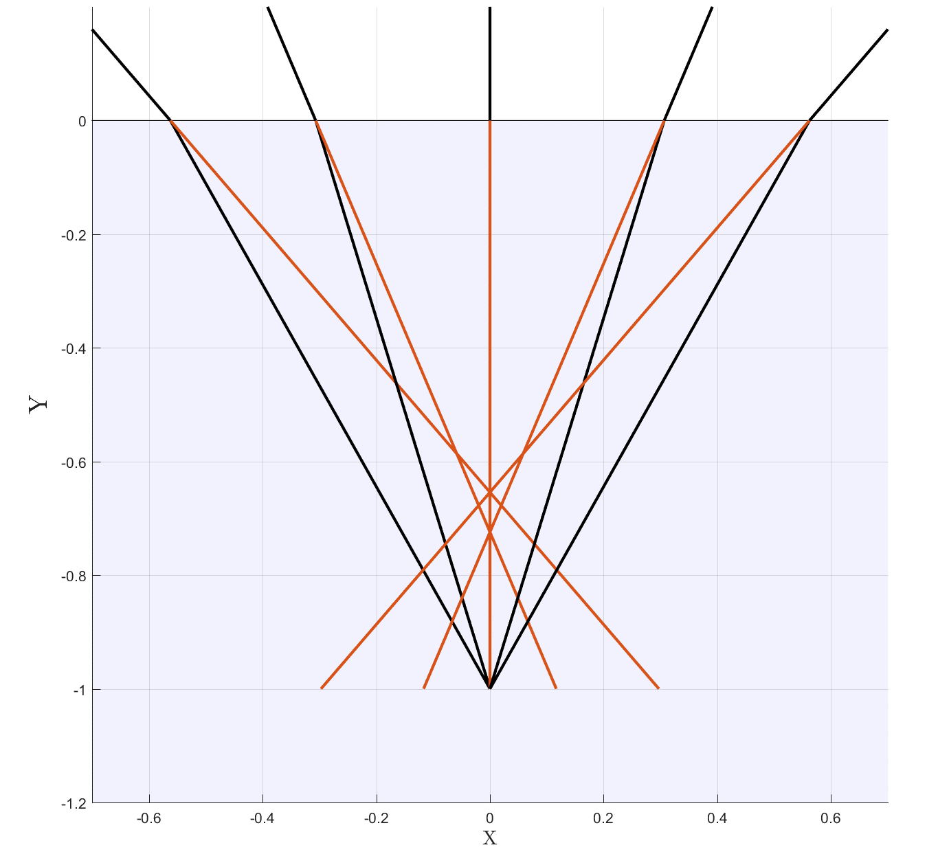
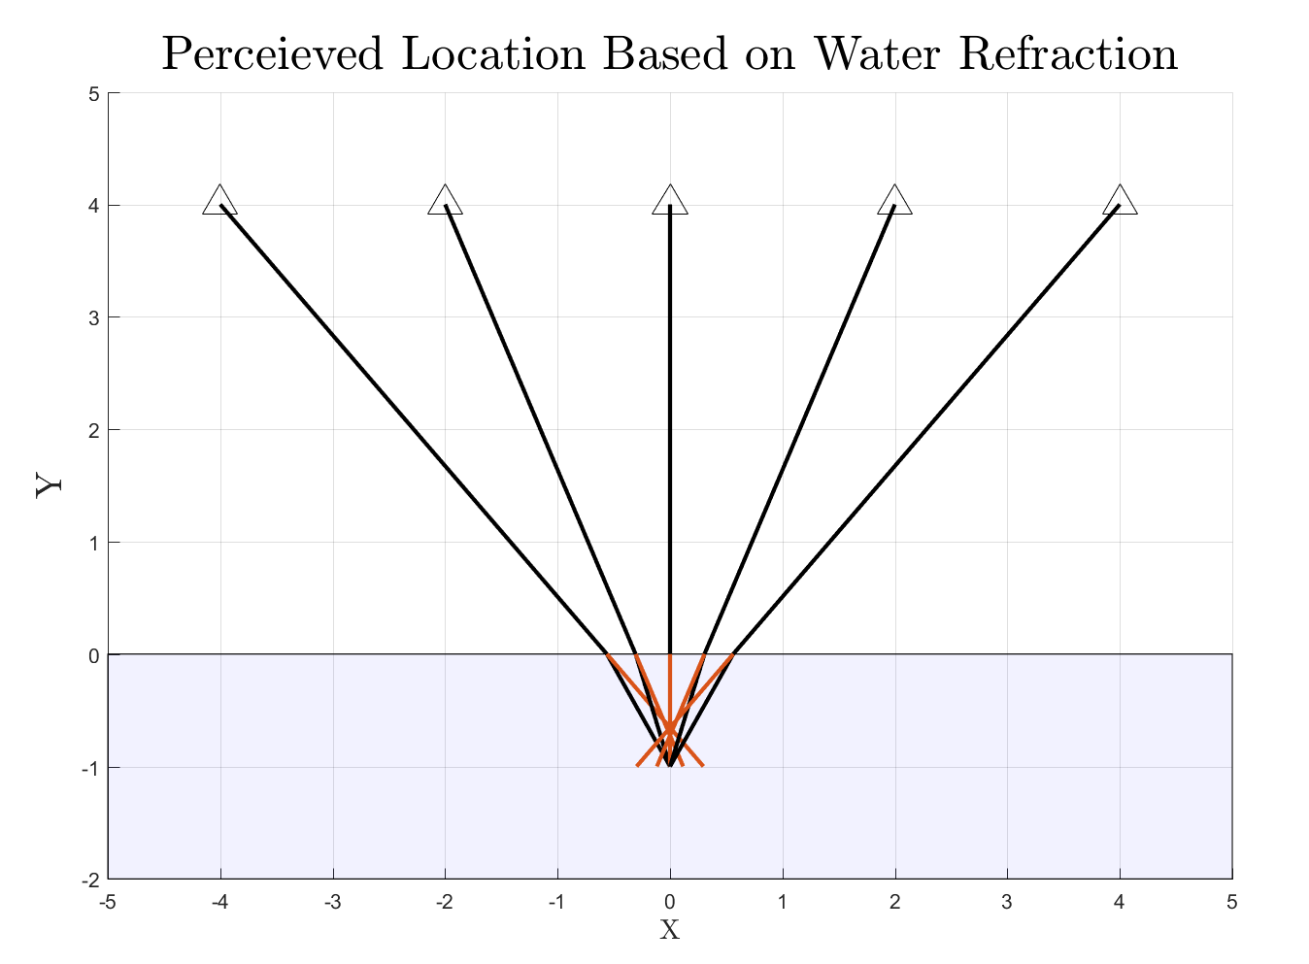
2D Refraction Induced Error

Slide 8
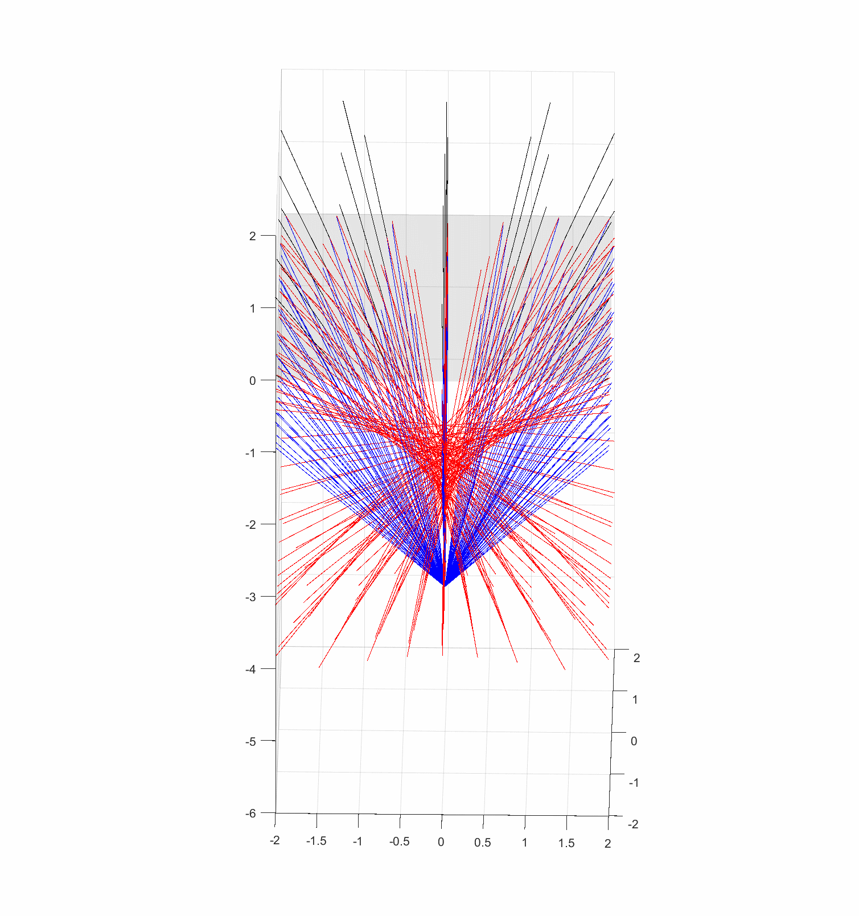
3D Refraction Induced Error
Red = “Perceived” Rays
Blue = True Refracted Rays
“Perceived” Rays do not converge

Slide 9
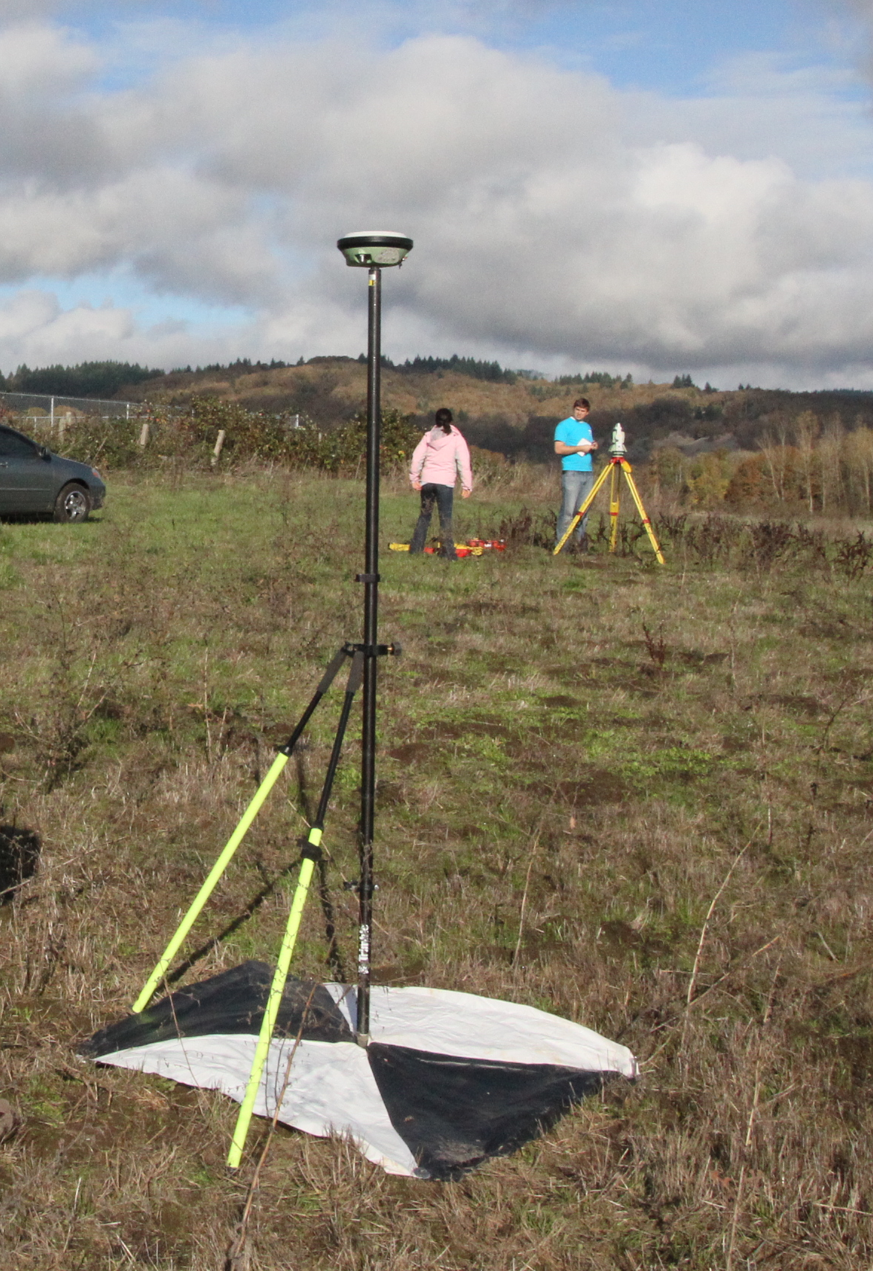
Robust SfM Simulations are Challenging
Time Consuming
collect ground-truth data
process the data and click GCPs
Challenging to create a repeatable experiment
Sun angle changes
Camera pose is not precise
Results are often site specific
Texture
Flying altitude
Time of day
GCP distribution, etc

Slide 10
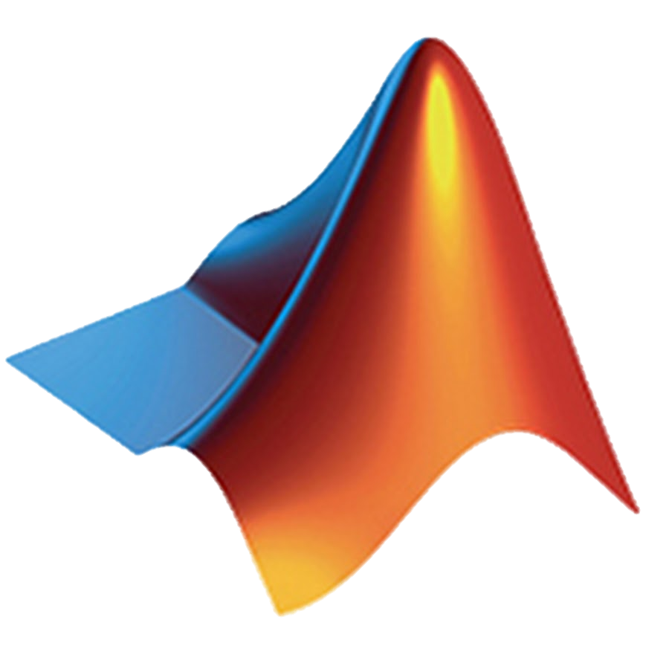



simUAS
Matlab
Generate Simulation XML Files
user input
Image rendering methodology to simulate UAS RGB images for SfM accuracy assessments
simUAS (Blender + Python + Matlab)
Batch Process Simulations
Output Simulated Imagery and Metadata
Full control of Independent Variables
Groundtruth data has no uncertainty
Repeat experiments are possible
100s of simulations can be processed in an attempt to generalize results
Matlab
Generate Photoscan Processing XML Files
user input
Agiproc (Photoscan + Python)
Process all simulations in Photoscan
Output Pointcloud and other Computed Parameters
Matlab
Process and Analyze Data
Generate Figures + Computed Equations
user input

Slide 11
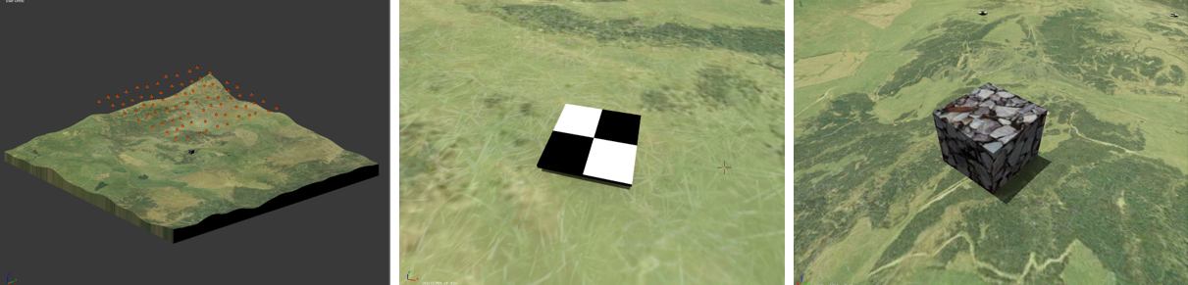
Example Simulation
How does the “dense quality” in Agisoft Photoscan affect pointcloud accuracy?
Slocum and Parrish, 2017

Slide 12
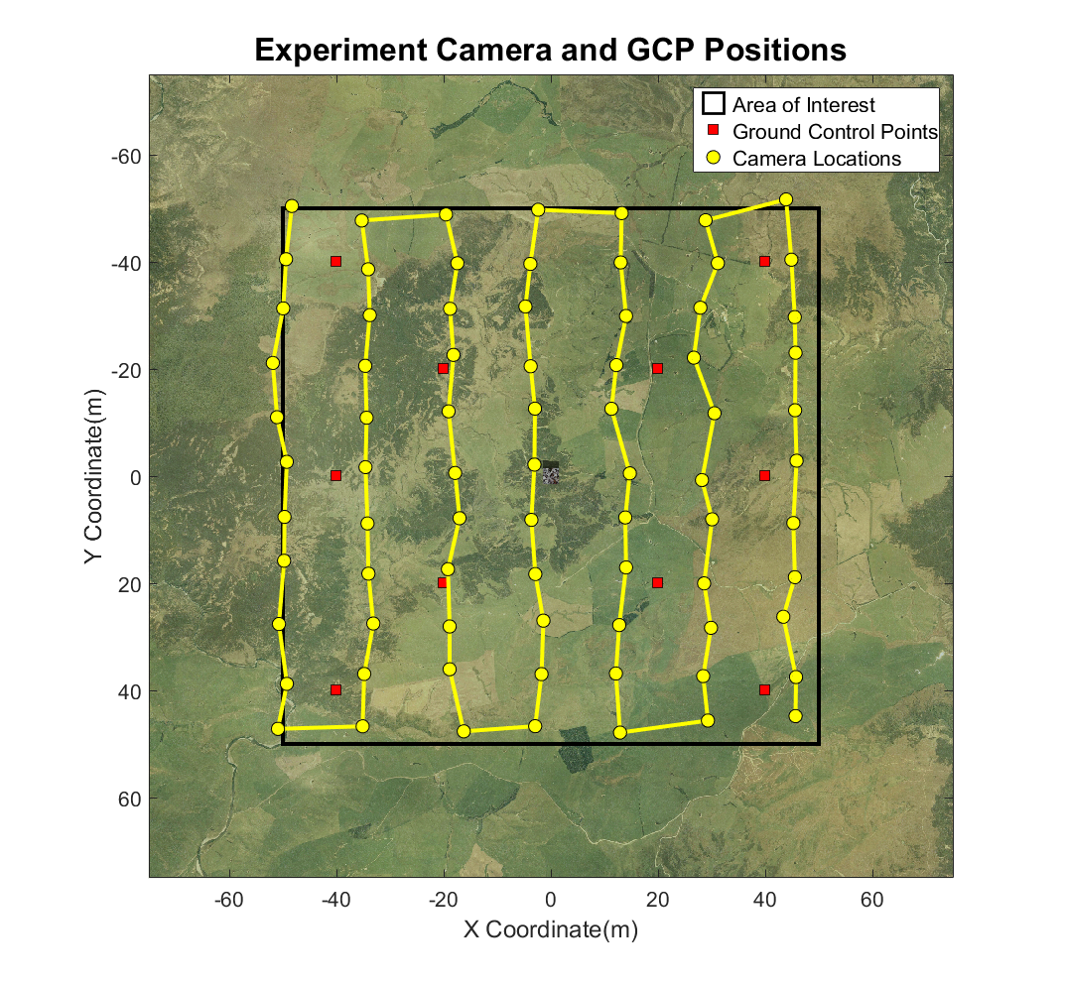
Example Simulation
77 Images
A5000 Camera w/ ~72° hFOV
5456 x 3632 pixels
75% Overlap/Sidelap
No added uncertainty
10 GCPs
Trajectory
Camera Calibration

Slide 13
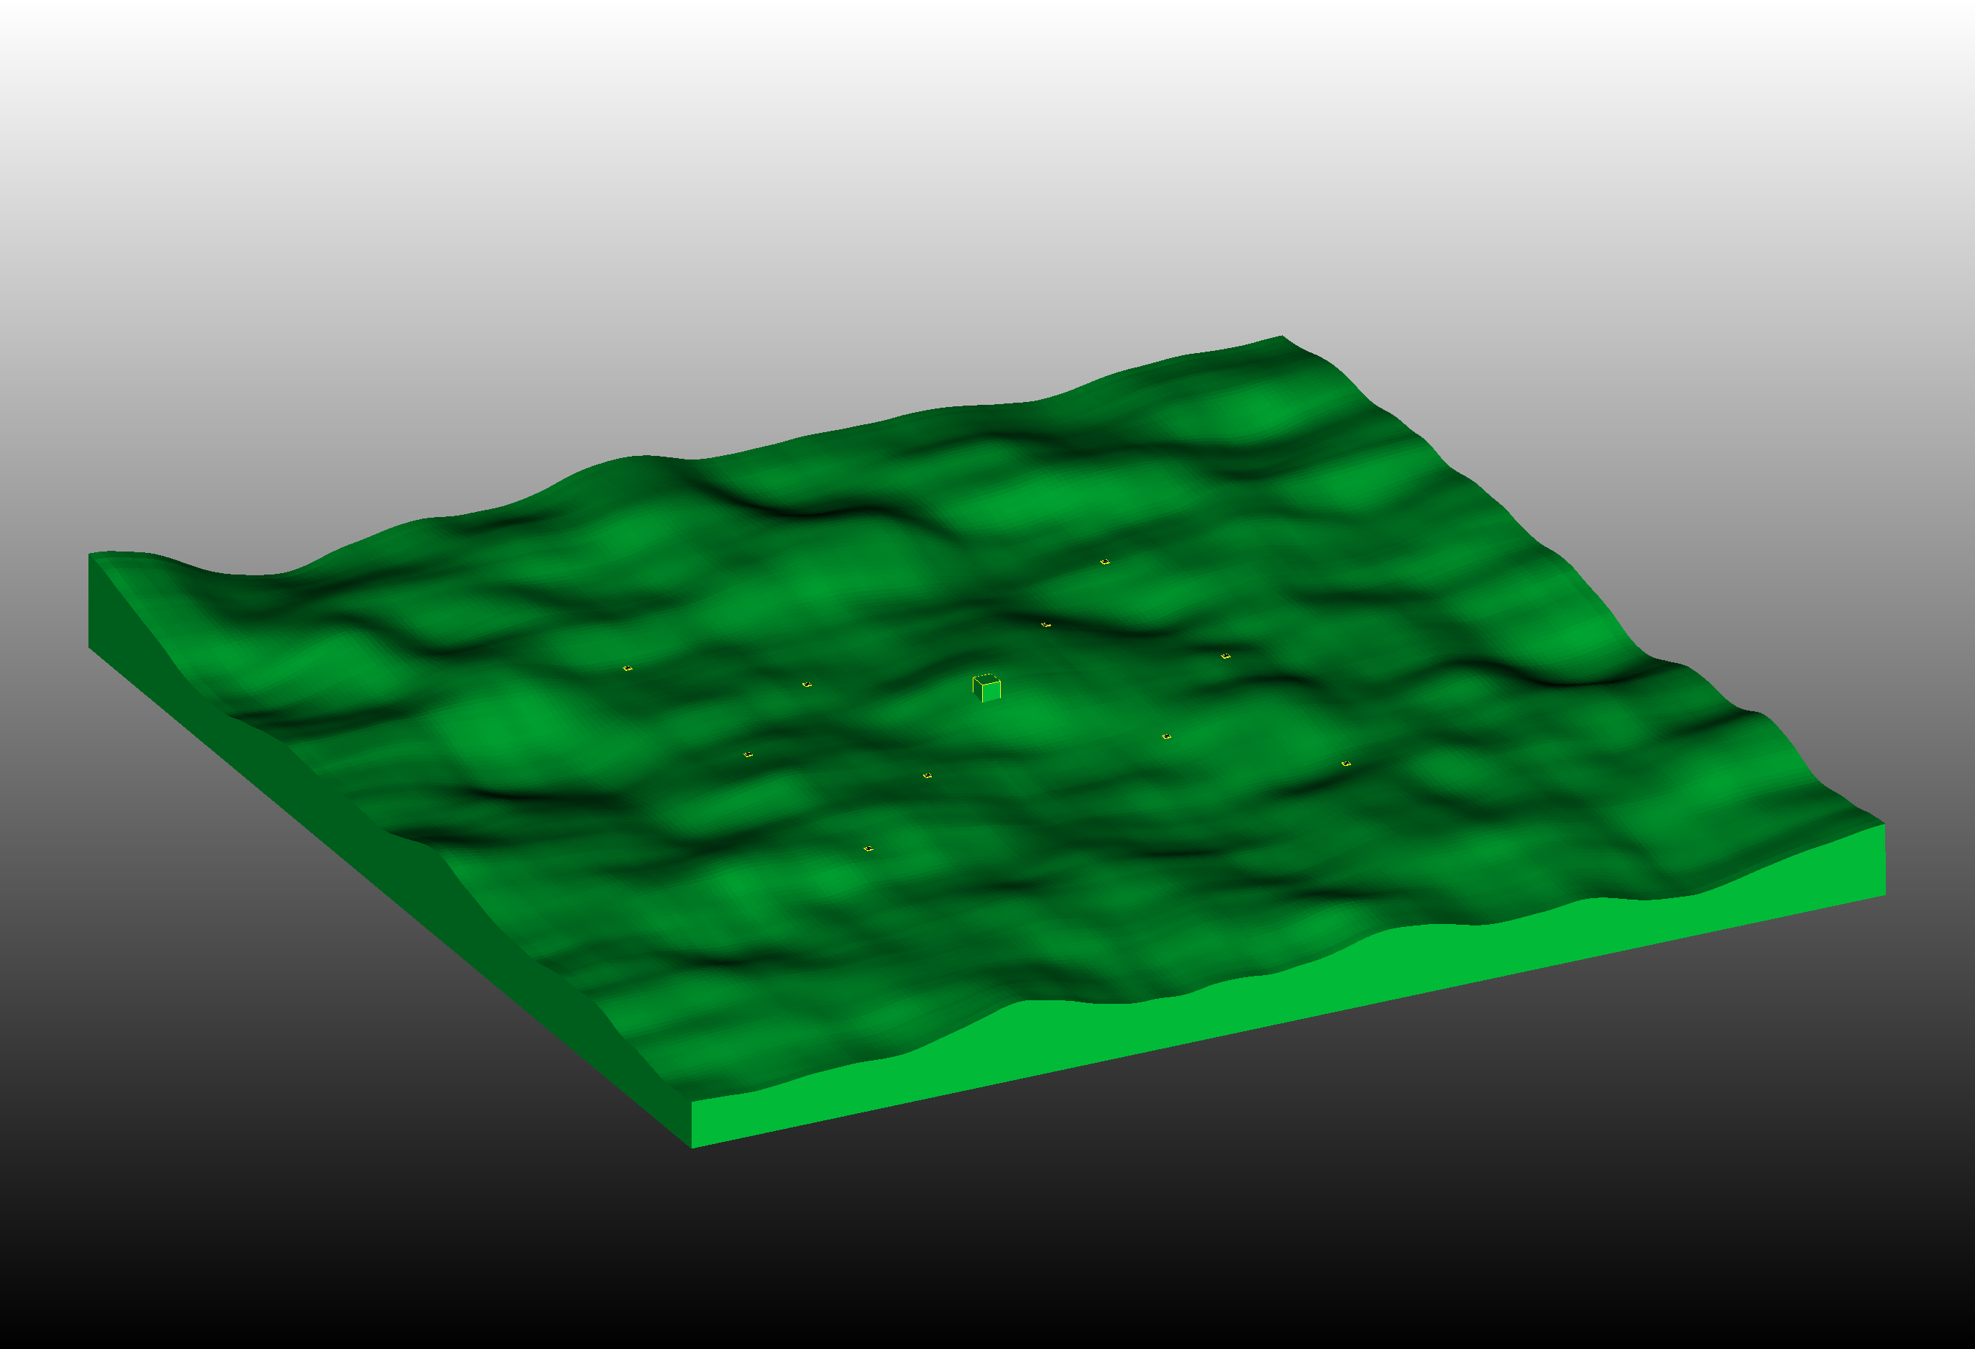
1. Generate Model

Slide 14
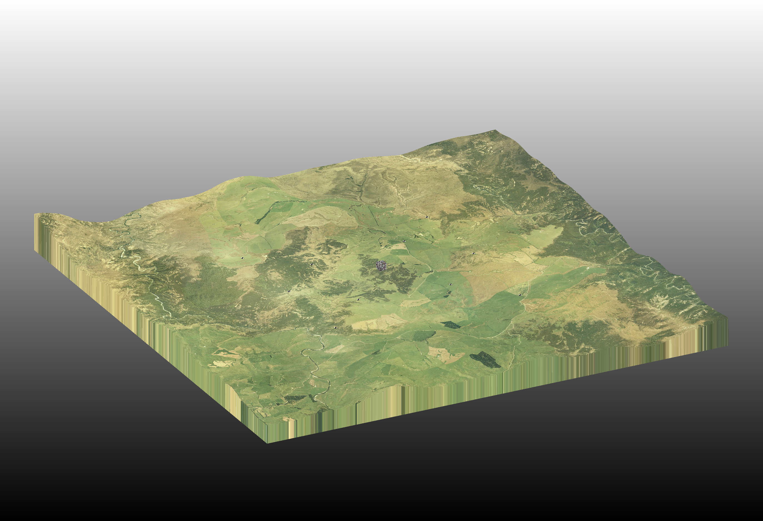
2. Texture Model

Slide 15
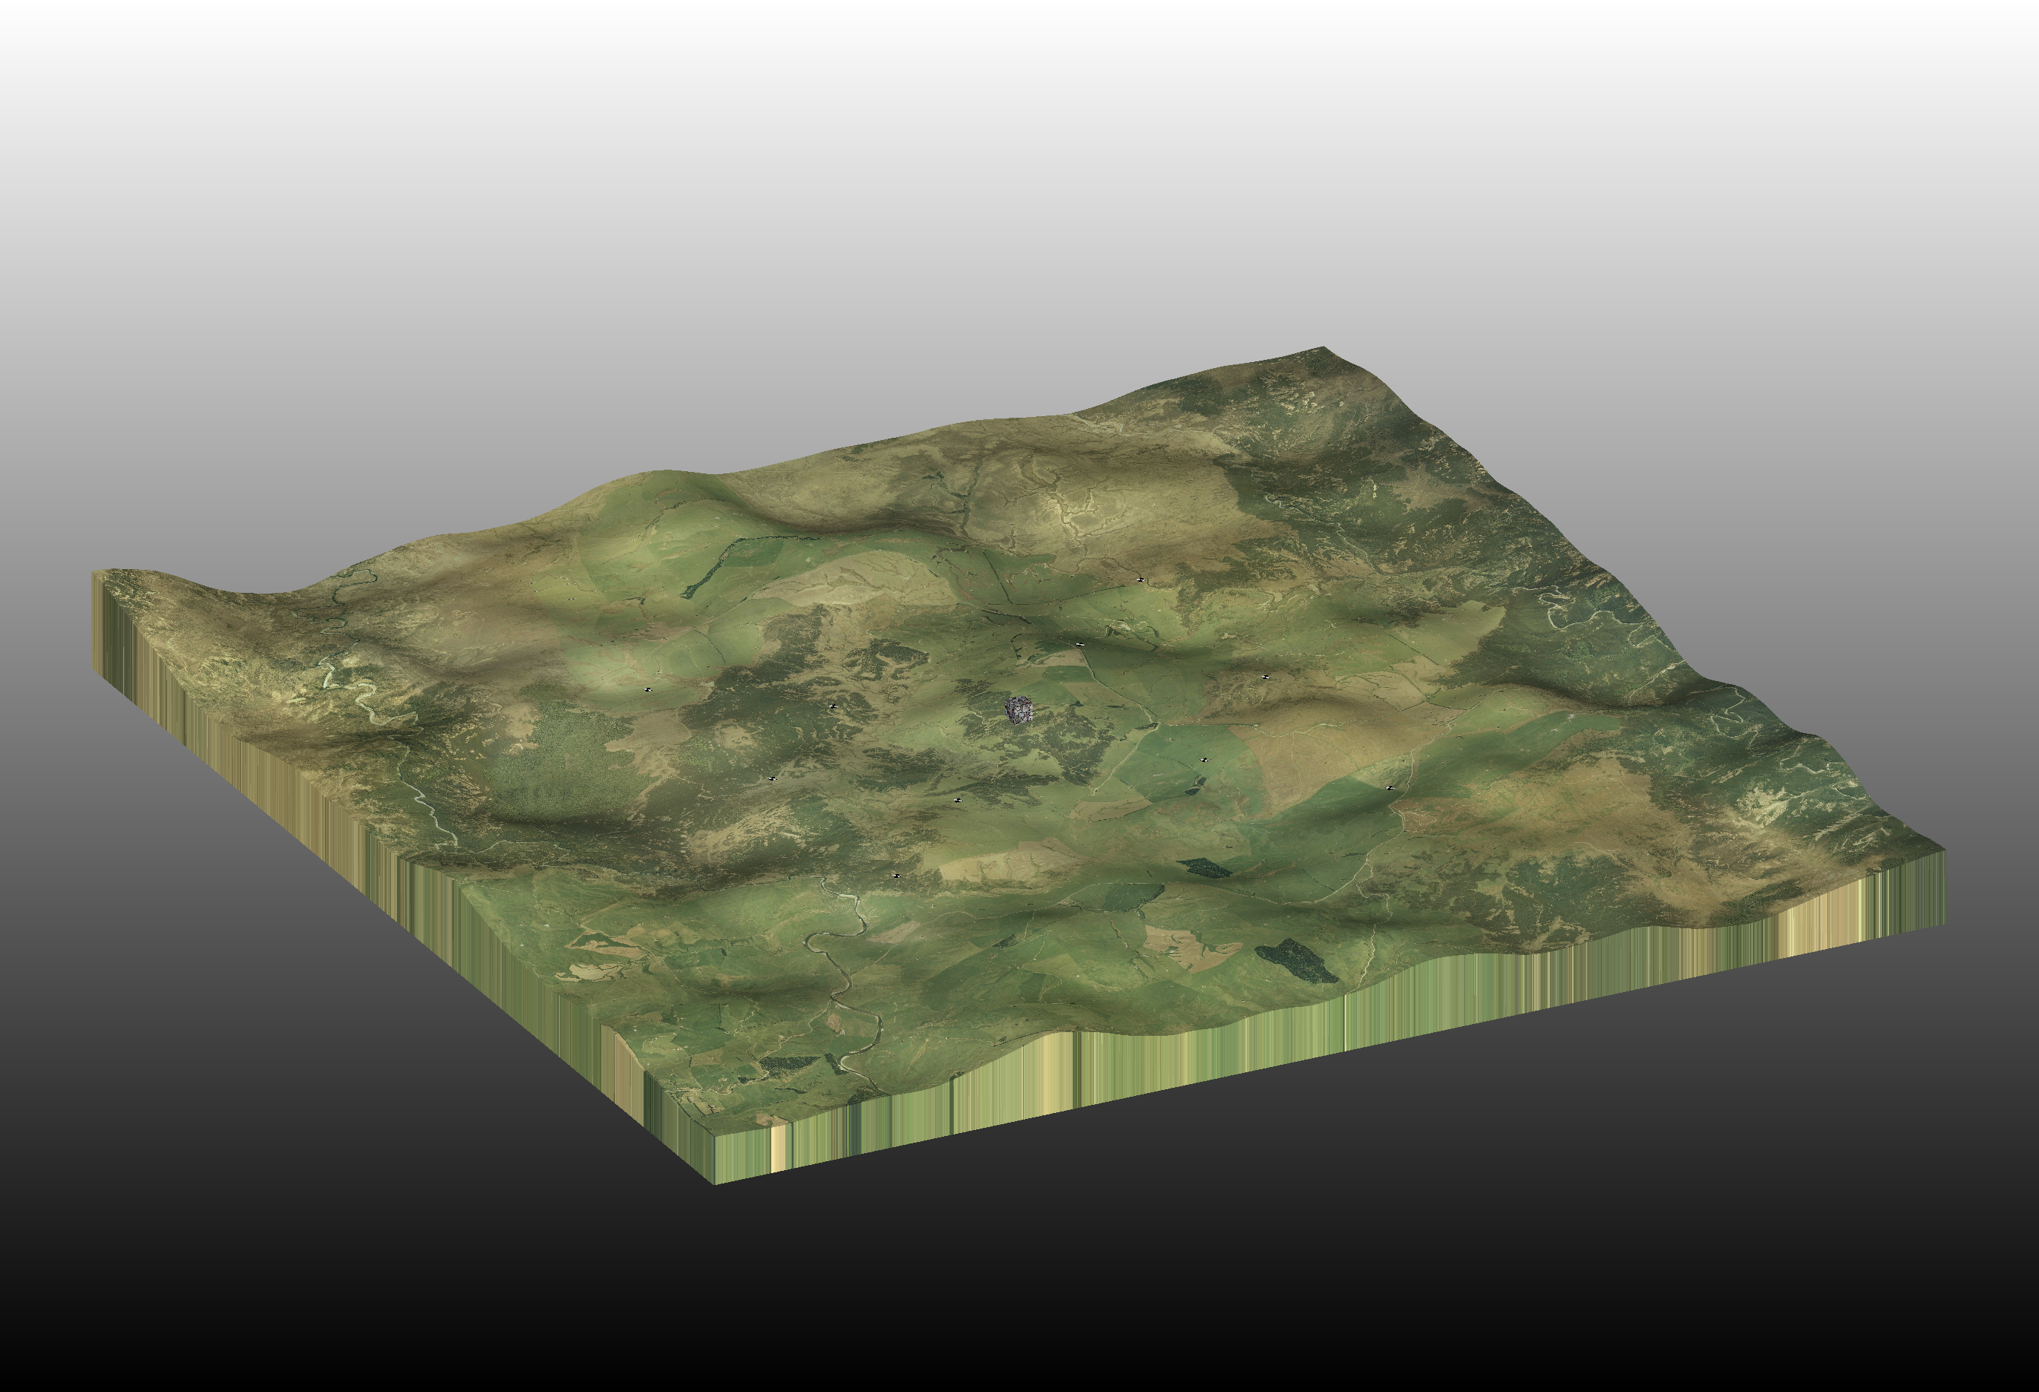
3. Add Lighting to Scene

Slide 16
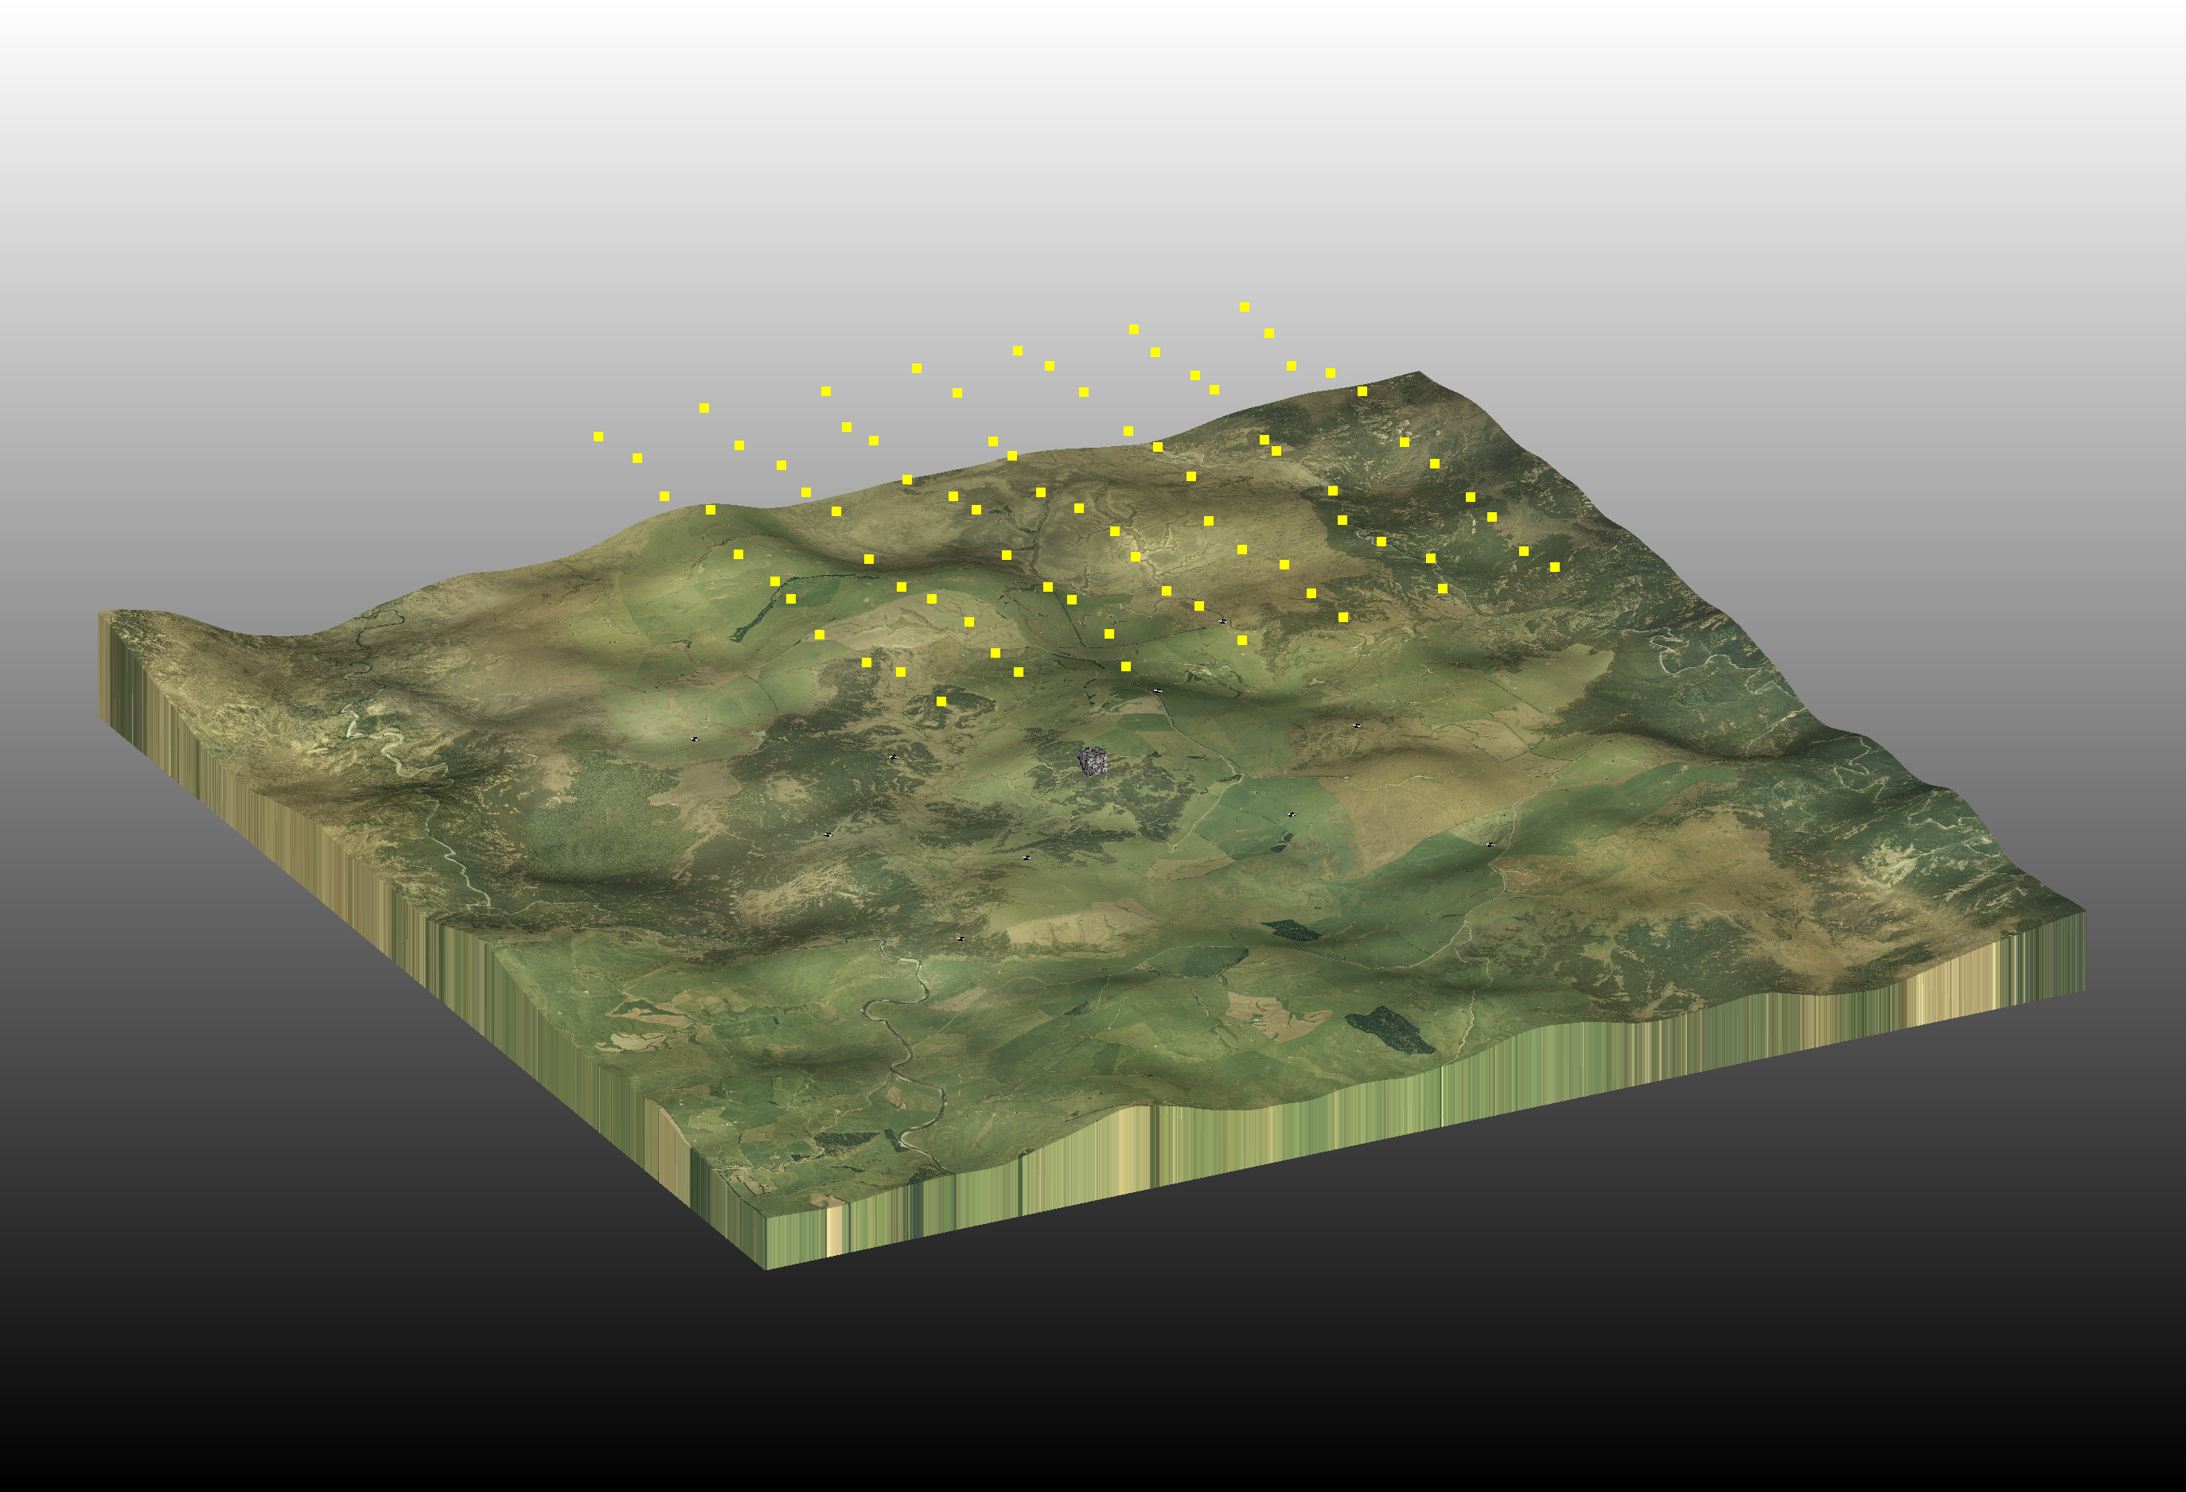
4. Add Cameras

Slide 17
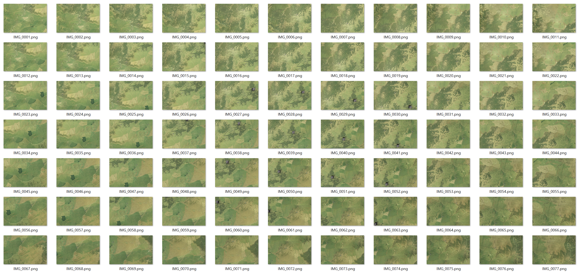
5. Render Imagery

Slide 18
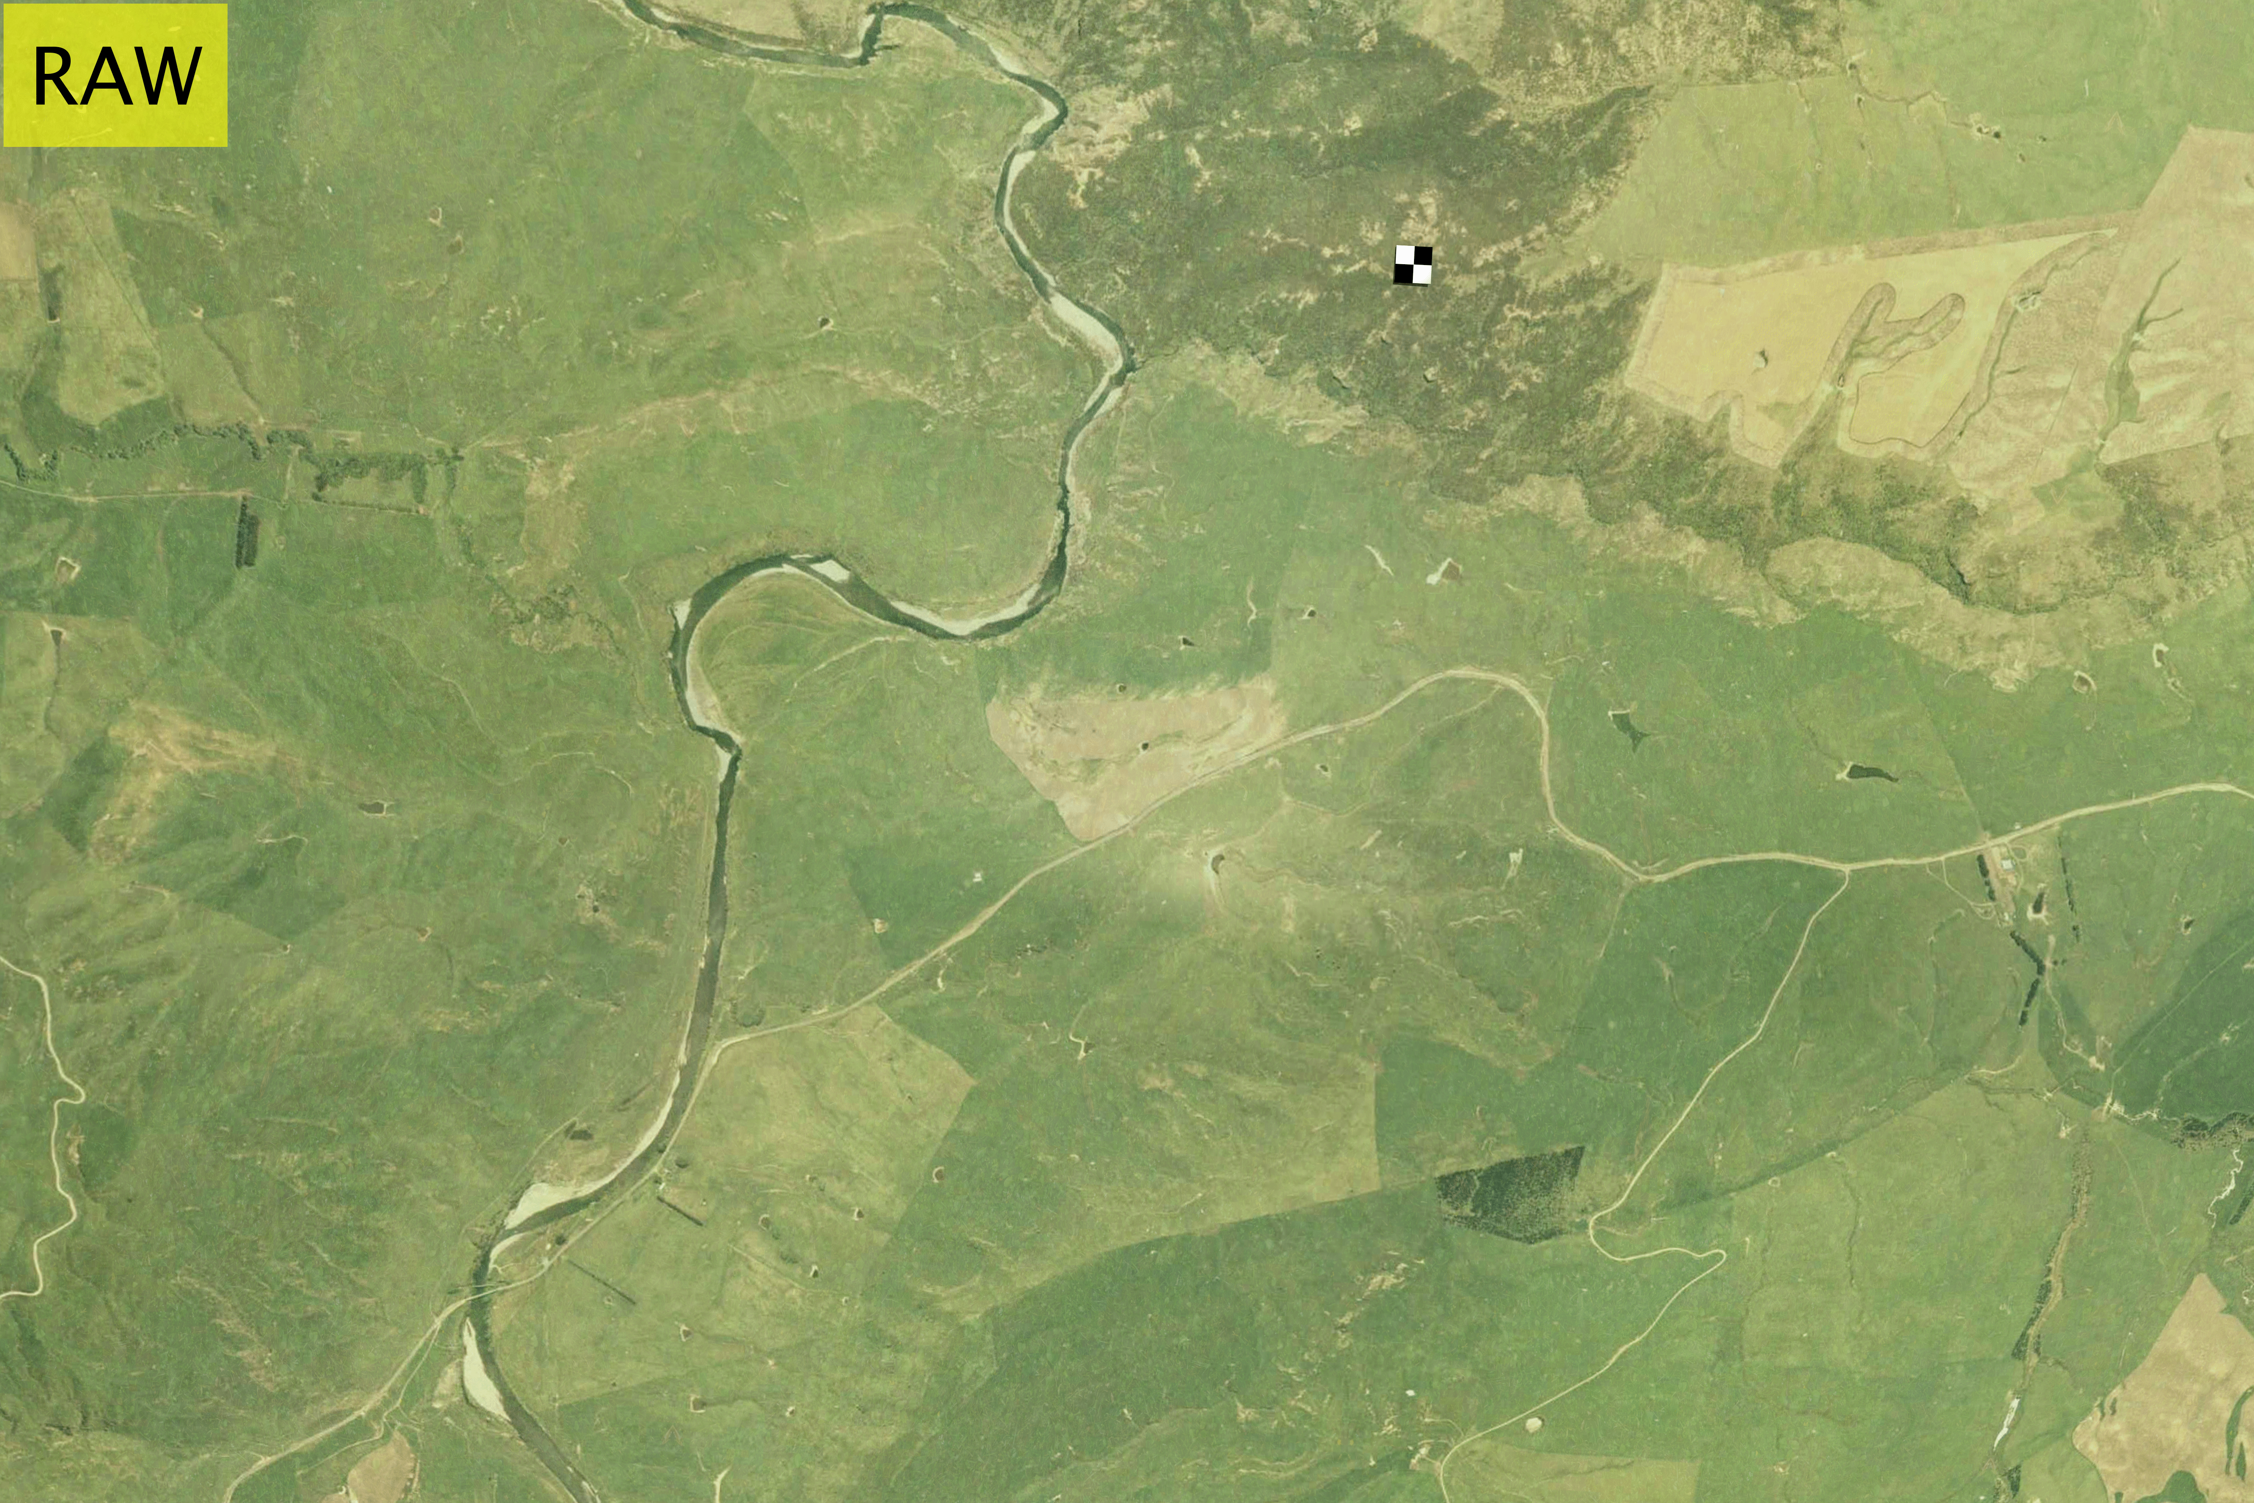
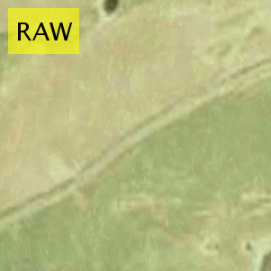
6. Postprocess Imagery
Lens Distortion
Vignetting
Gaussian Noise
Salt/Pepper Noise
Gaussian Blur
ZOOM

Slide 19
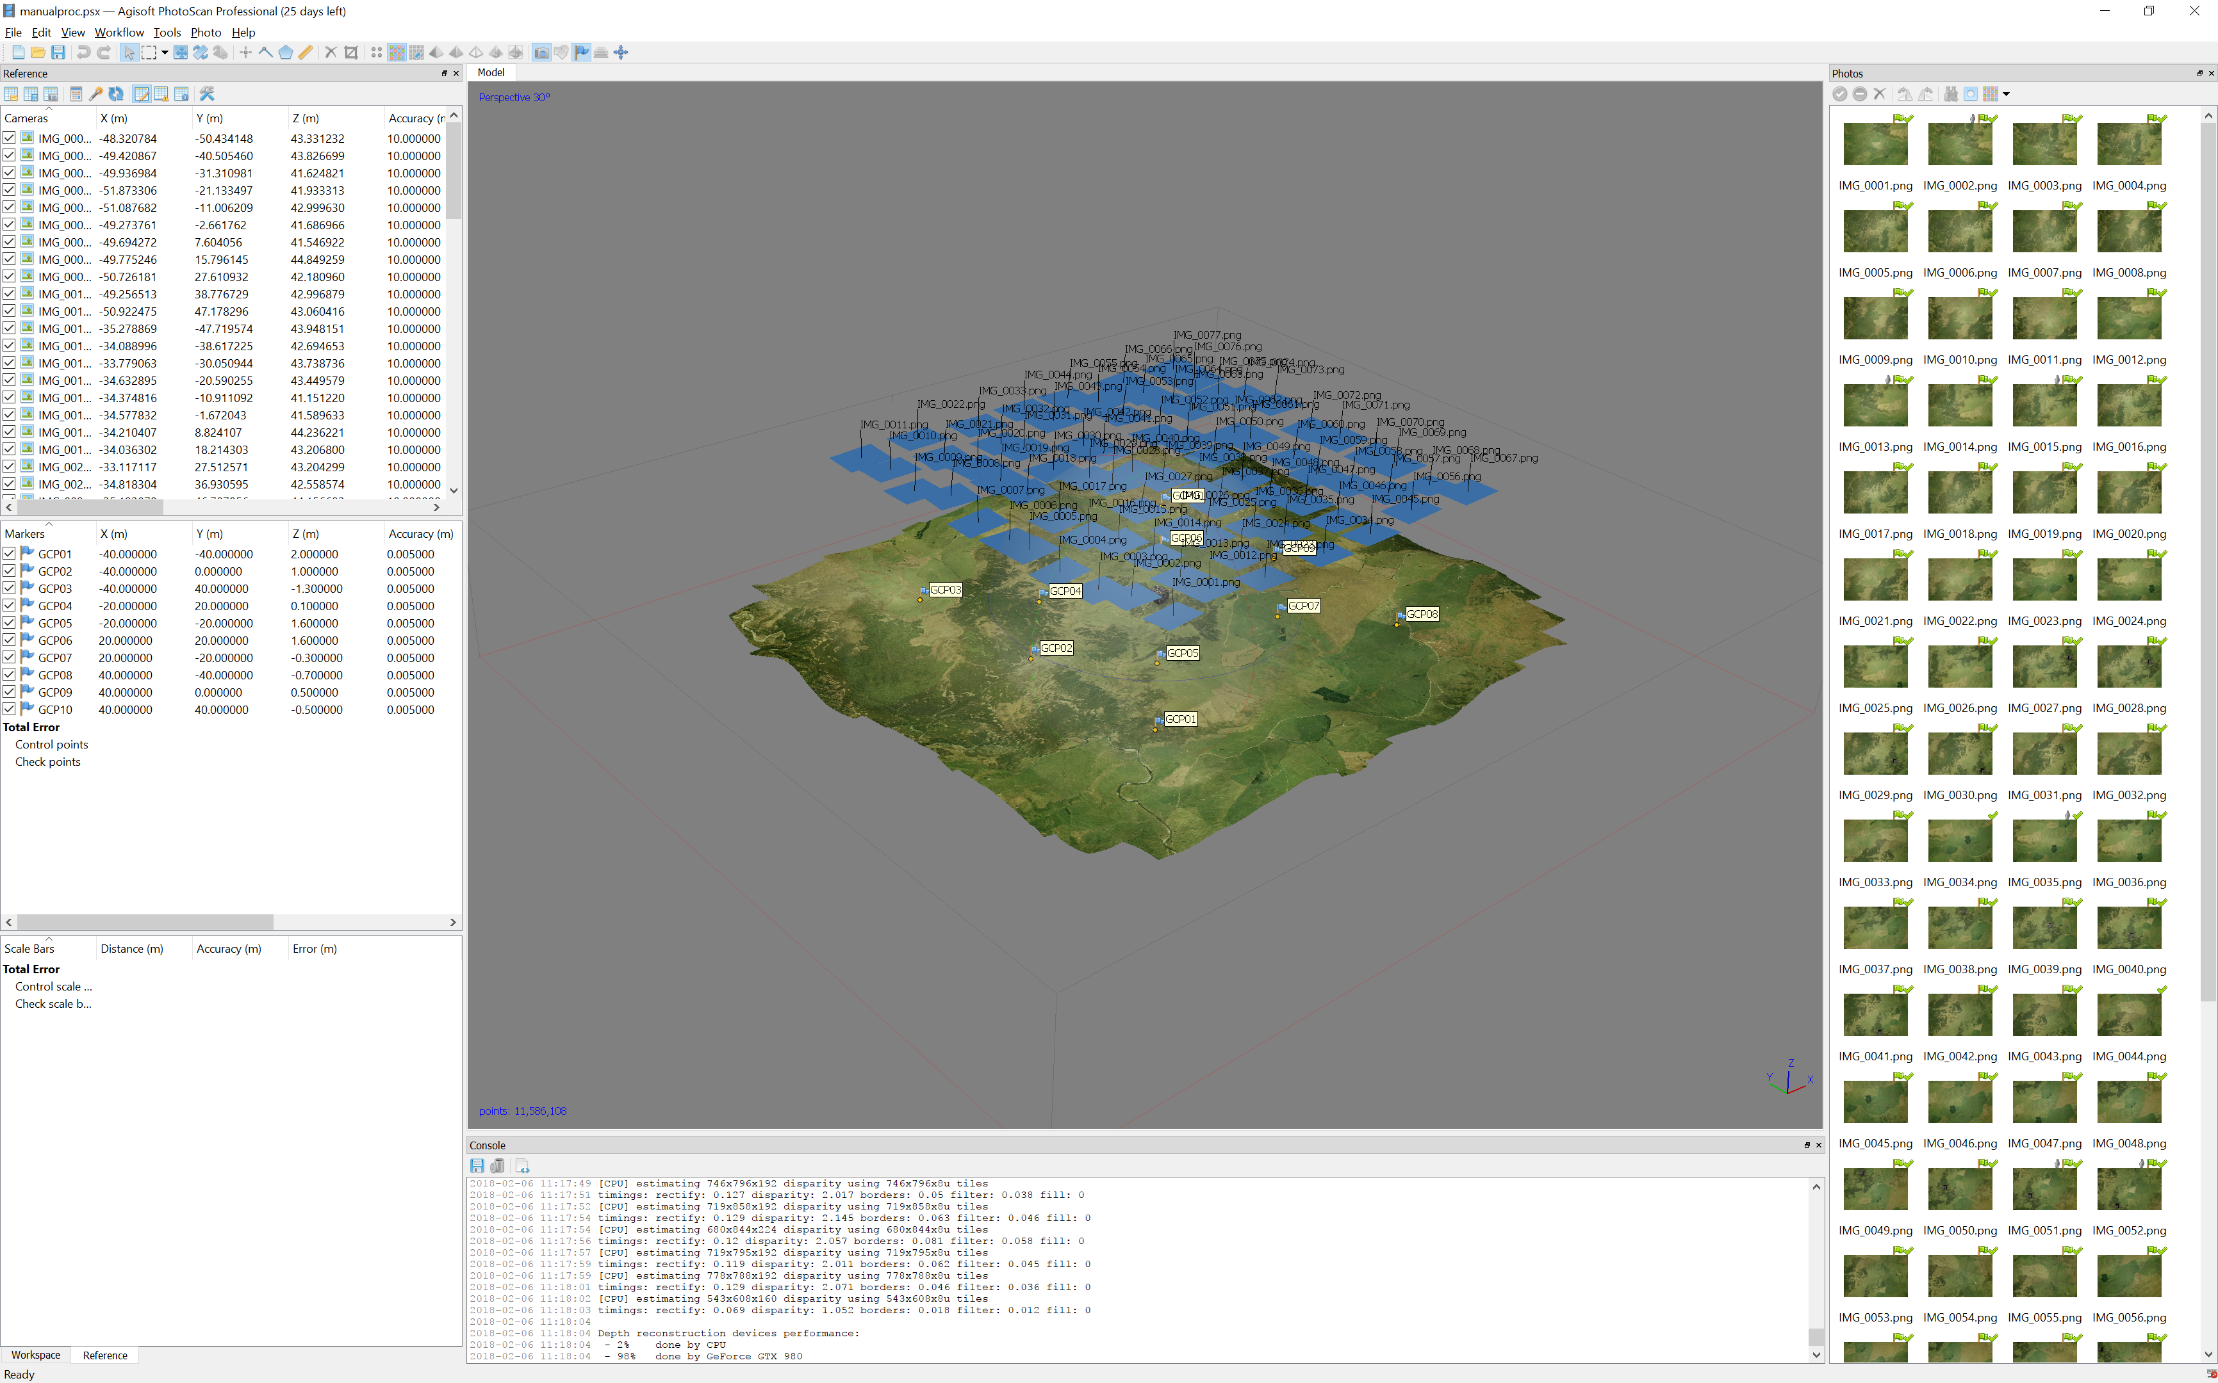
7. Process Data Using SfM

Slide 20
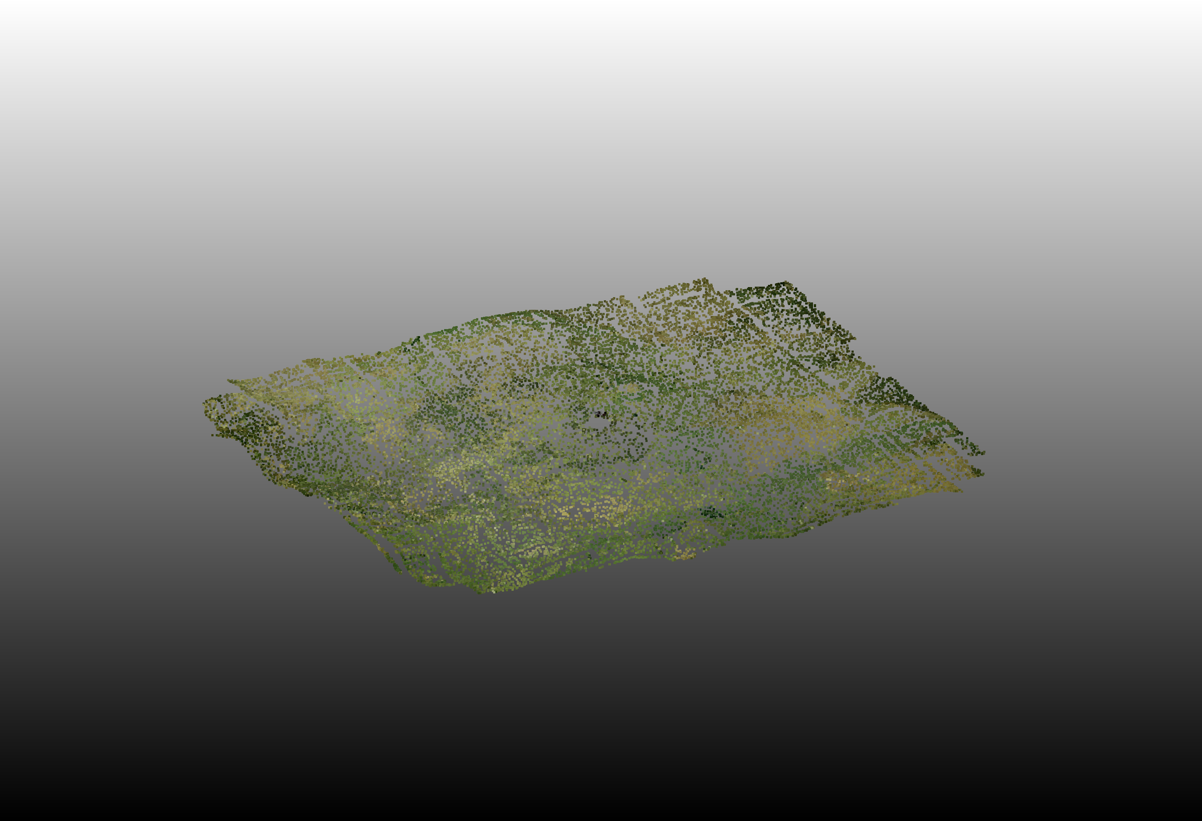
8. Generate Sparse Pointcloud

Slide 21
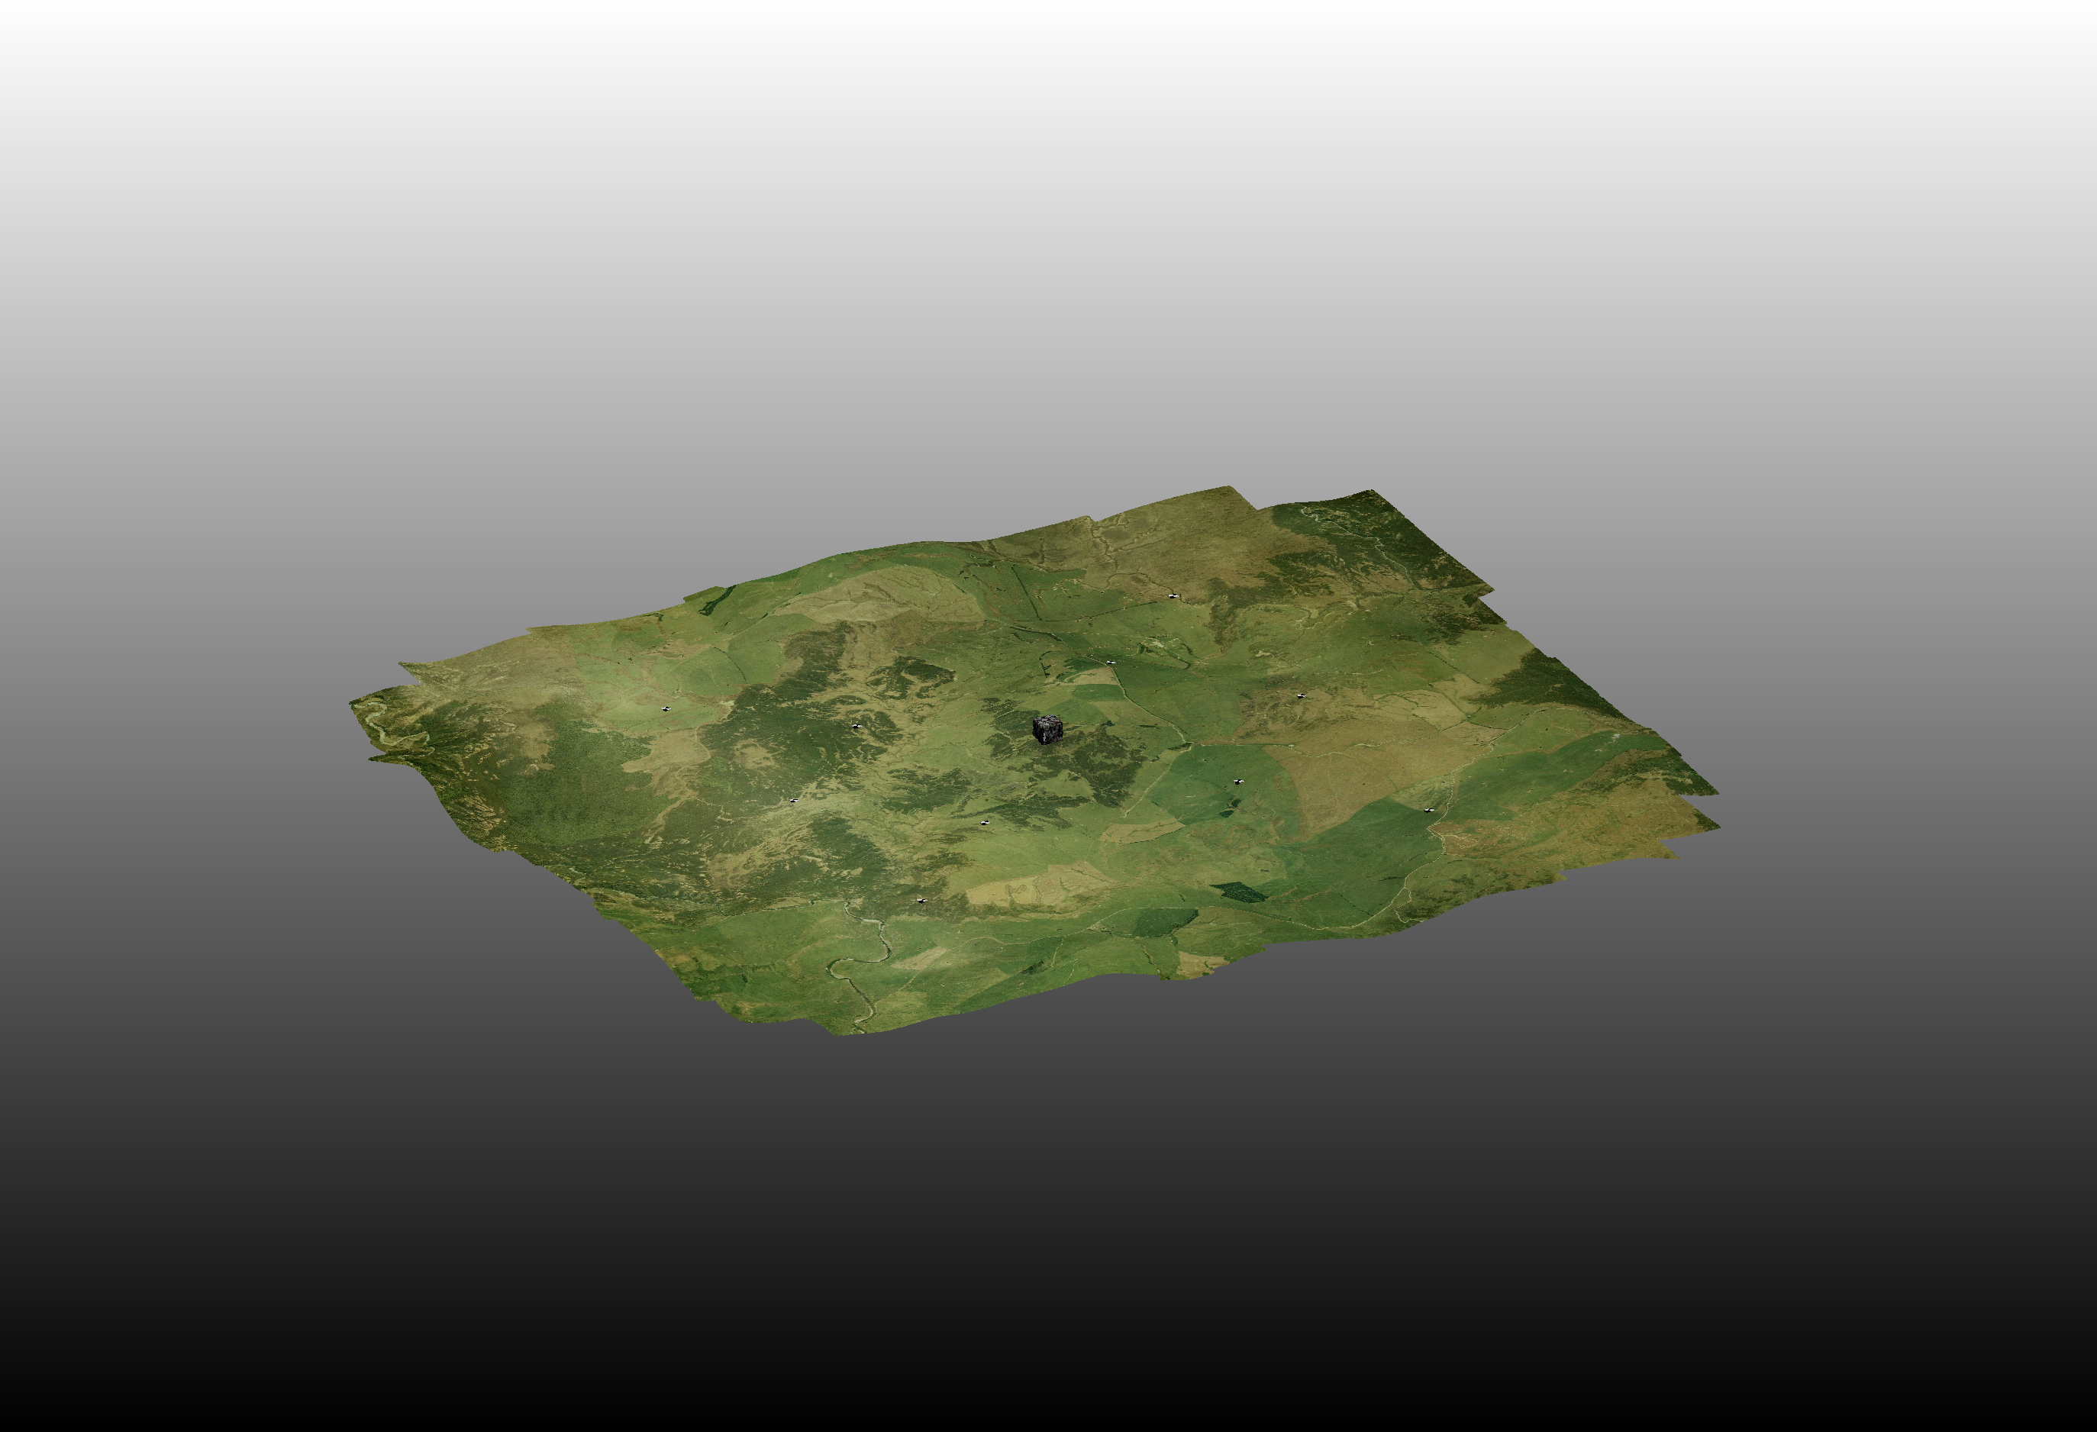
9. Generate Dense Pointcloud

Slide 22
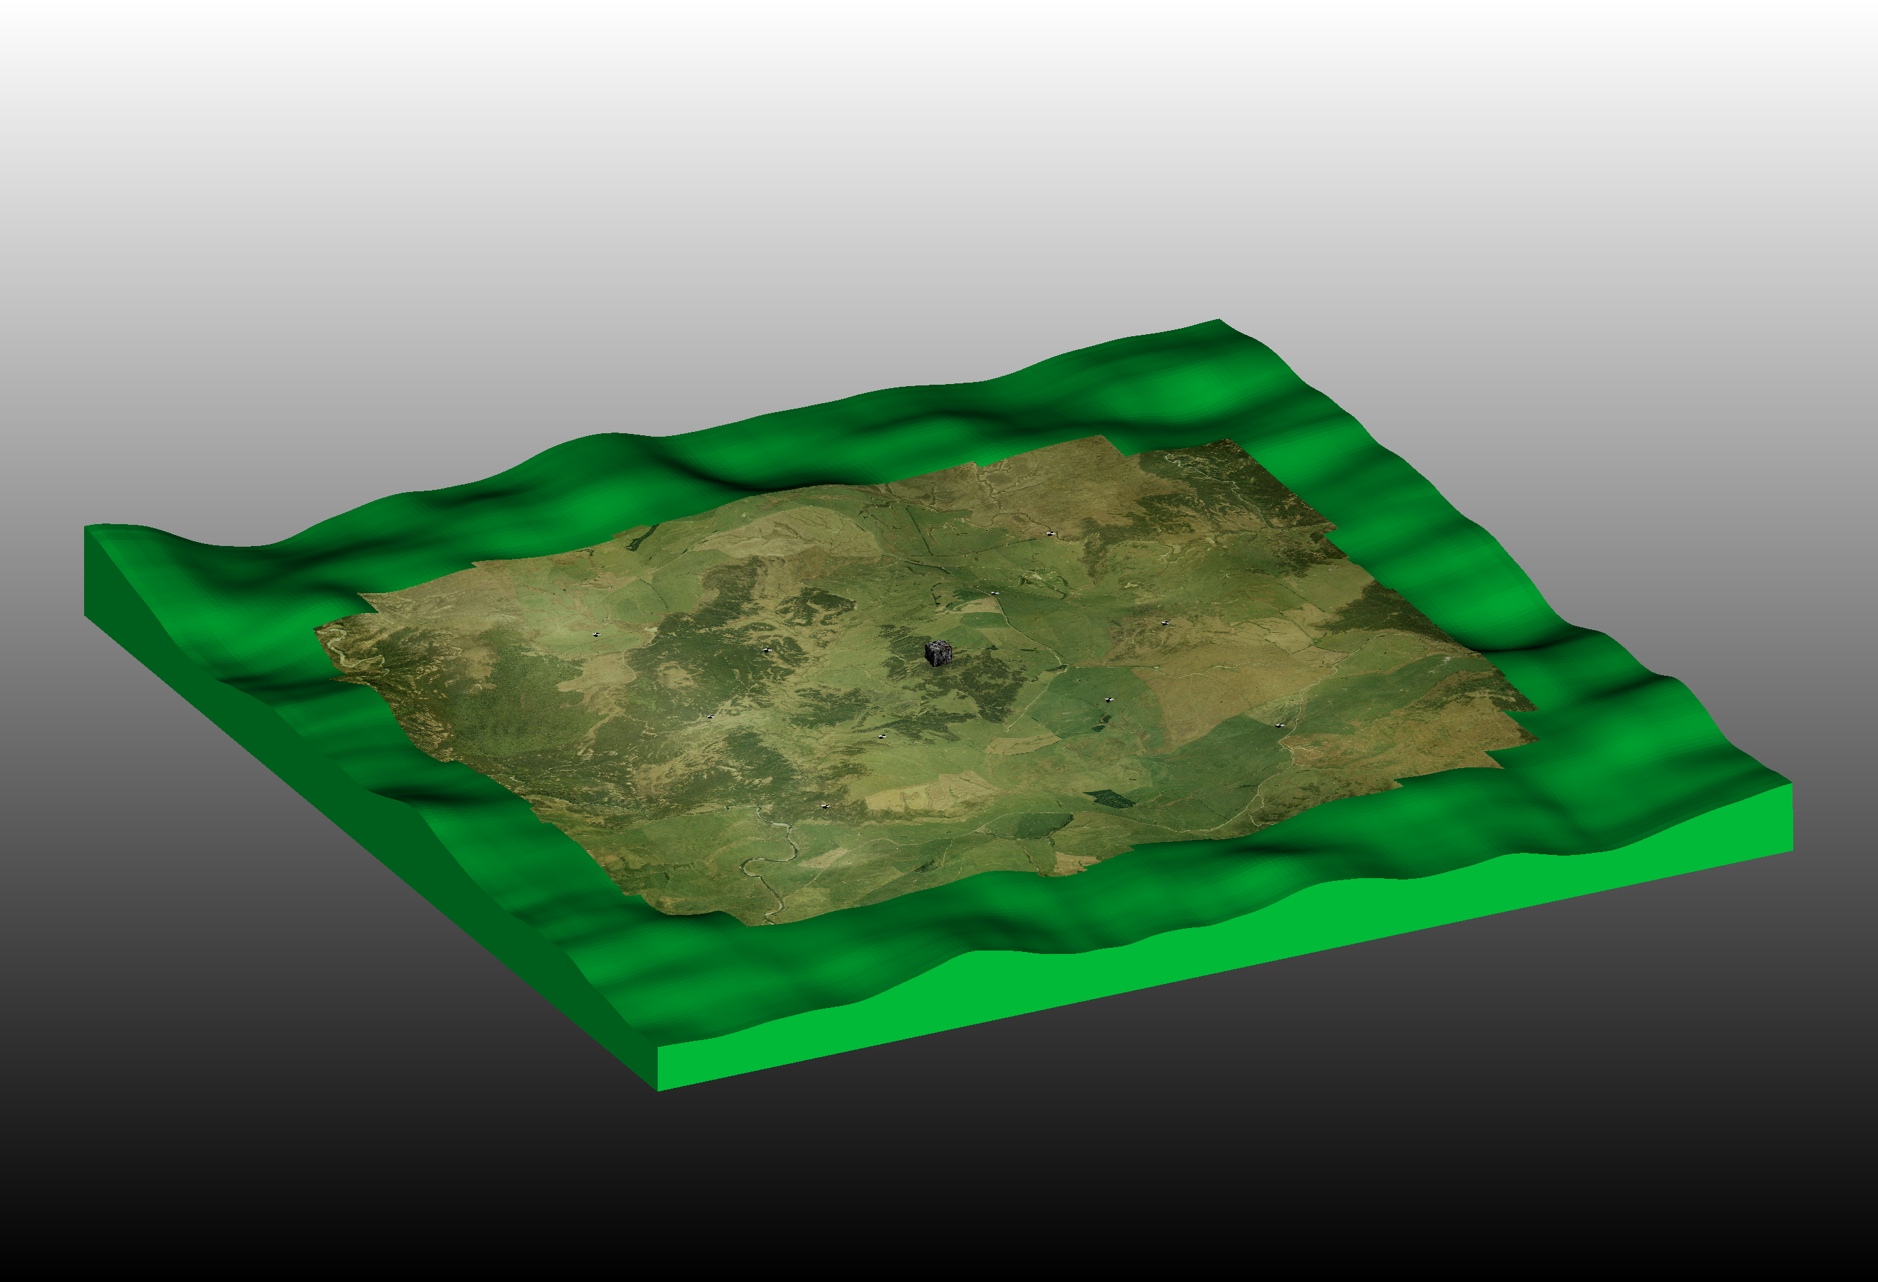
10. Compare Dense Pointcloud to Mesh

Slide 23
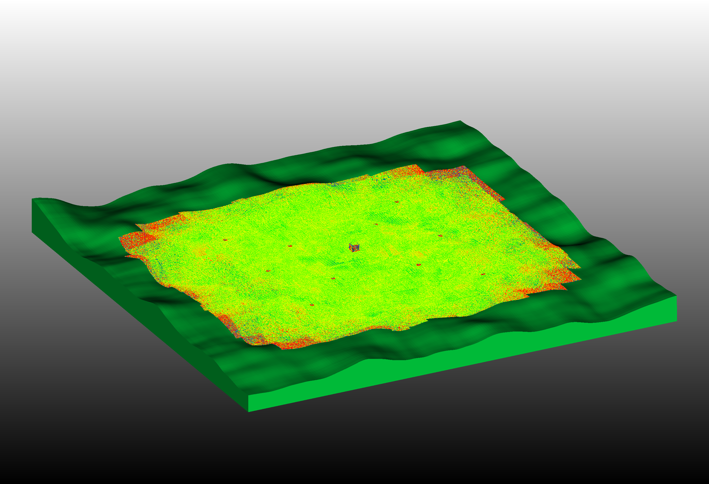
11. Compute Cloud to Mesh Distances

Slide 24
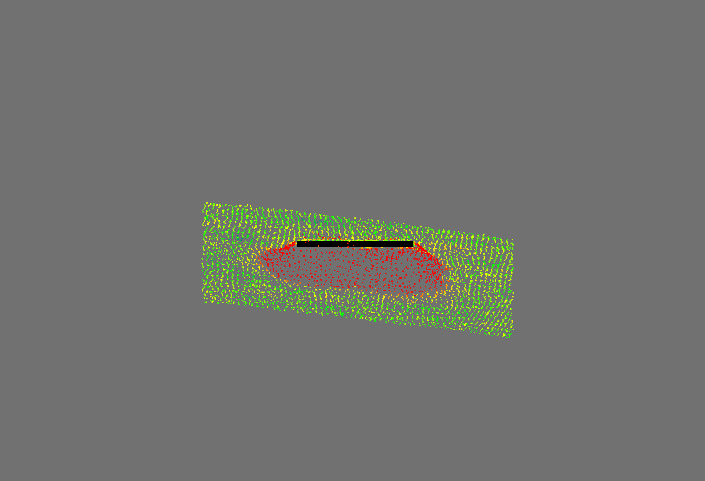
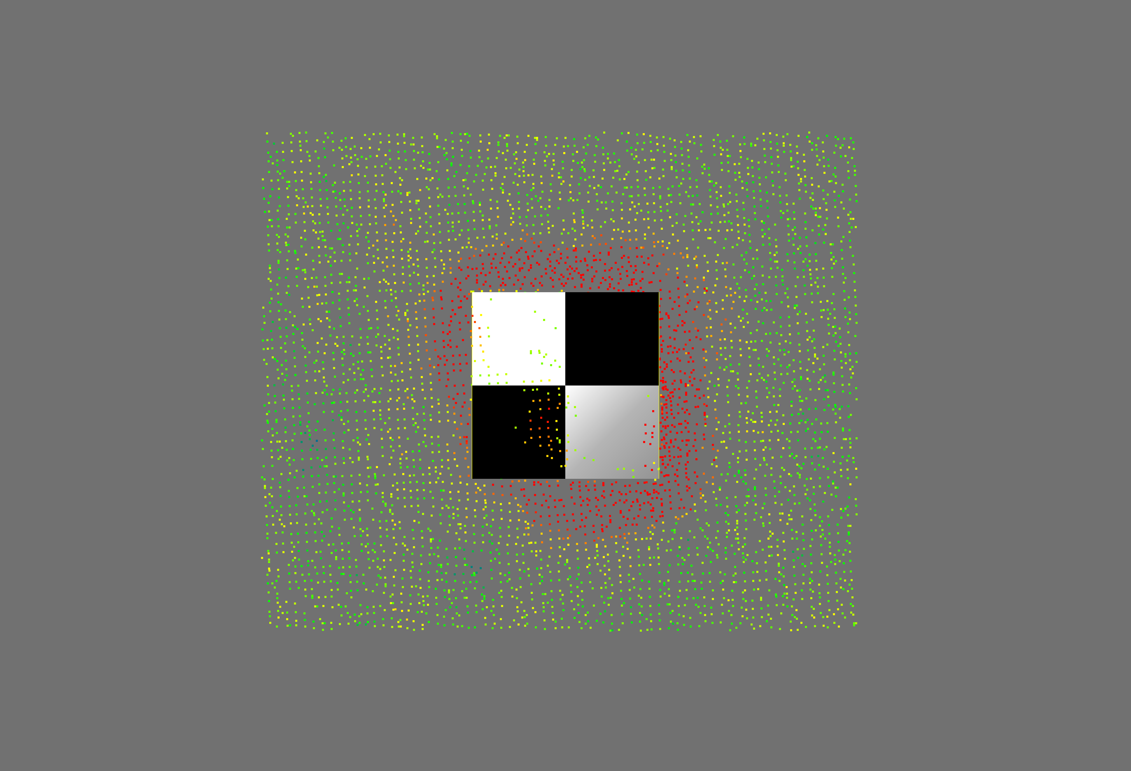
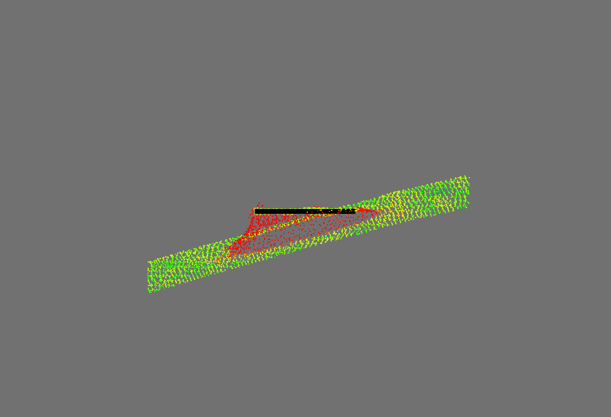
Qualitative Results

Slide 25
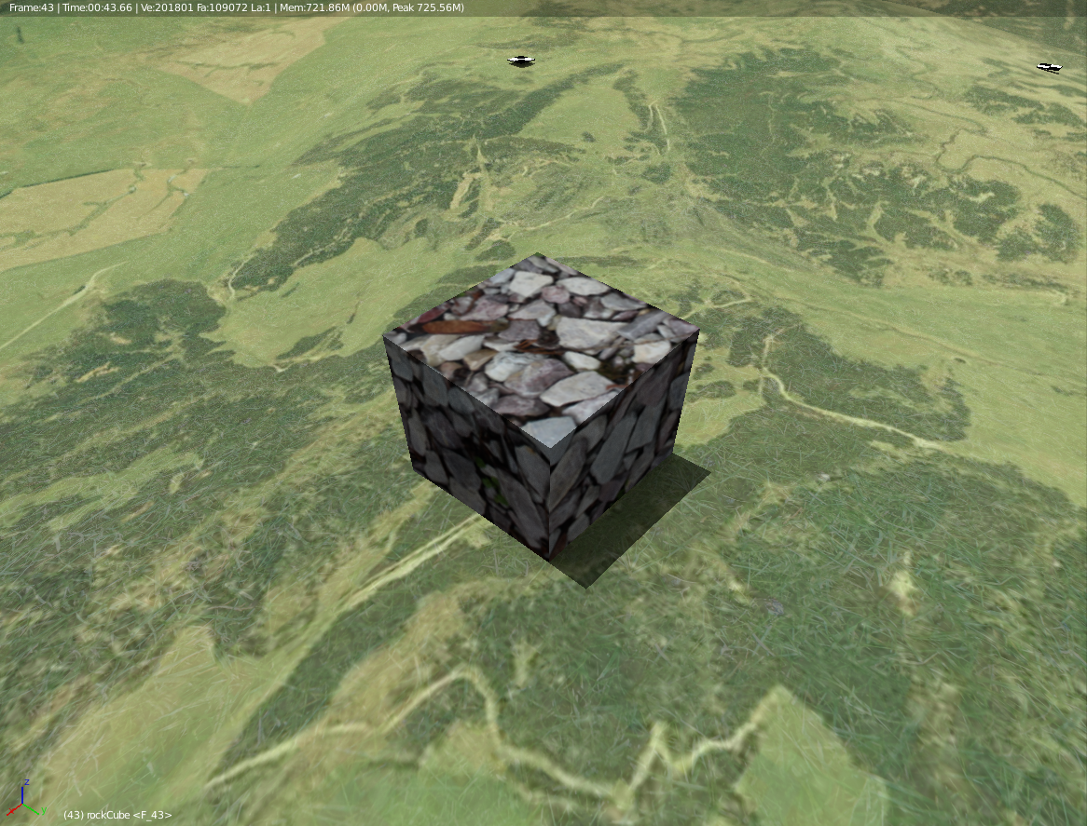
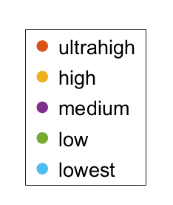
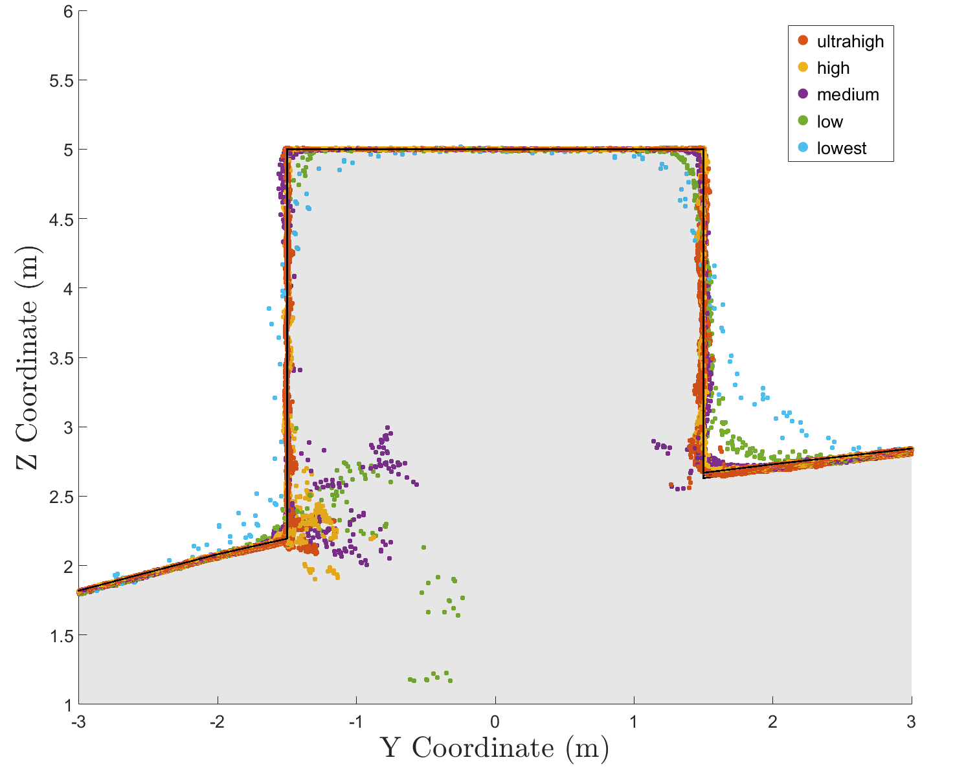
Qualitative Results
Lower Photoscan Dense Quality = round corners

Slide 26
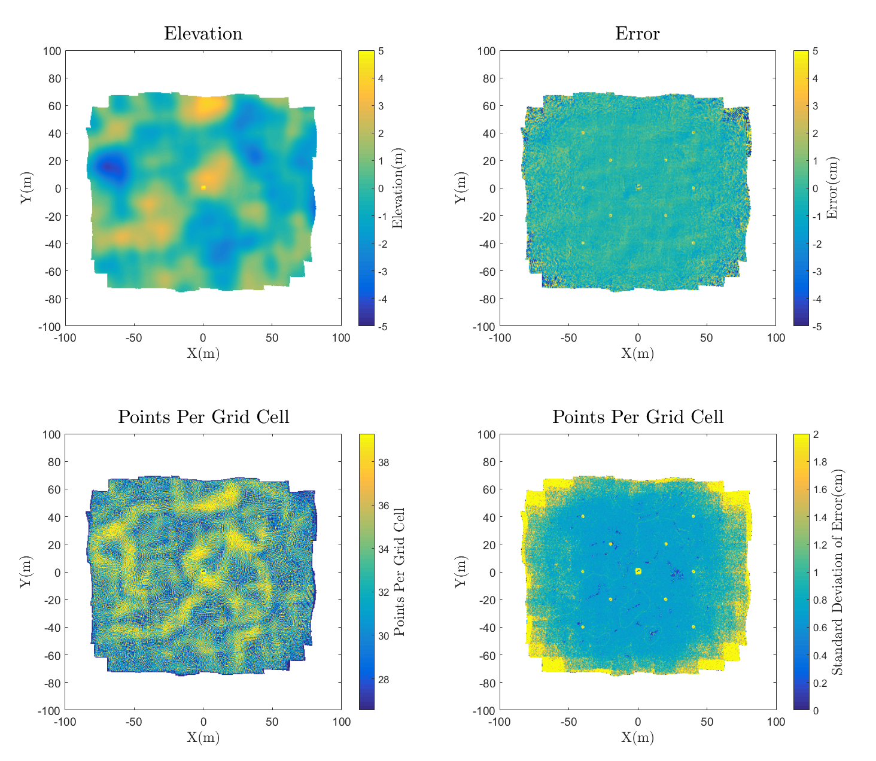
Quantitative Results
Compute error by comparing to groundtruth mesh

Slide 27
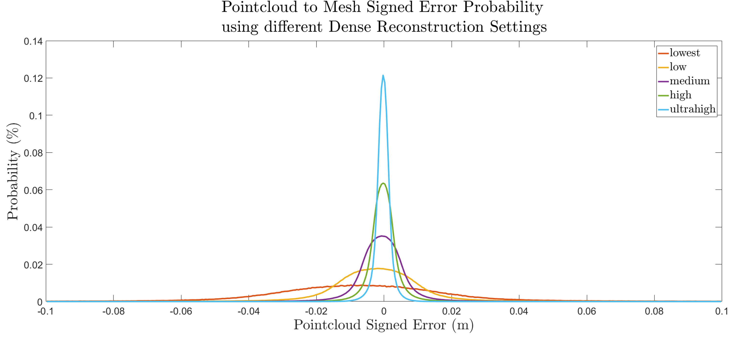
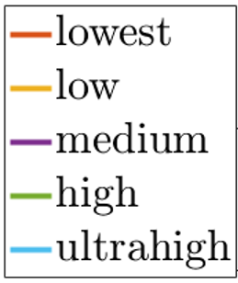
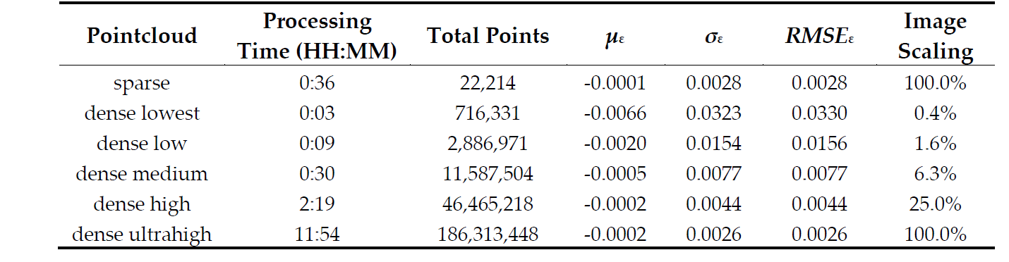
Quantitative Results
As Dense quality increases
Total points increase
Accuracy improves
Processing Time Increases
*CPU processing power can be a limiting factor

Slide 28
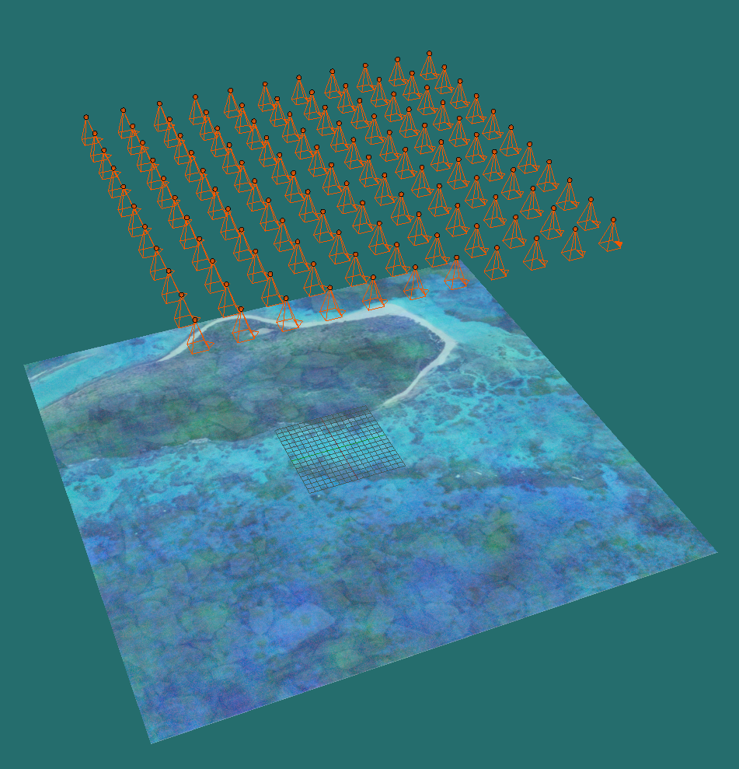
Bathymetry Experiment
How is SfM accuracy affected by:
- Camera Field of View
Water Depth
Simulation:
- Bathymetry = Flat Plane
- Water Surface = Flat Plane

Slide 29
Bathymetry Experiment
Satellite Image with Random RGB Noise
121 Images
Flight Lines: 11 x 11
2000 x 2000 pix
No Nonlinear Distortion
Perfect nadir and uniformly spaced EO
80% Overlap/Sidelap (at water surface)
100% Transparent water
No Specular Reflections

Slide 30
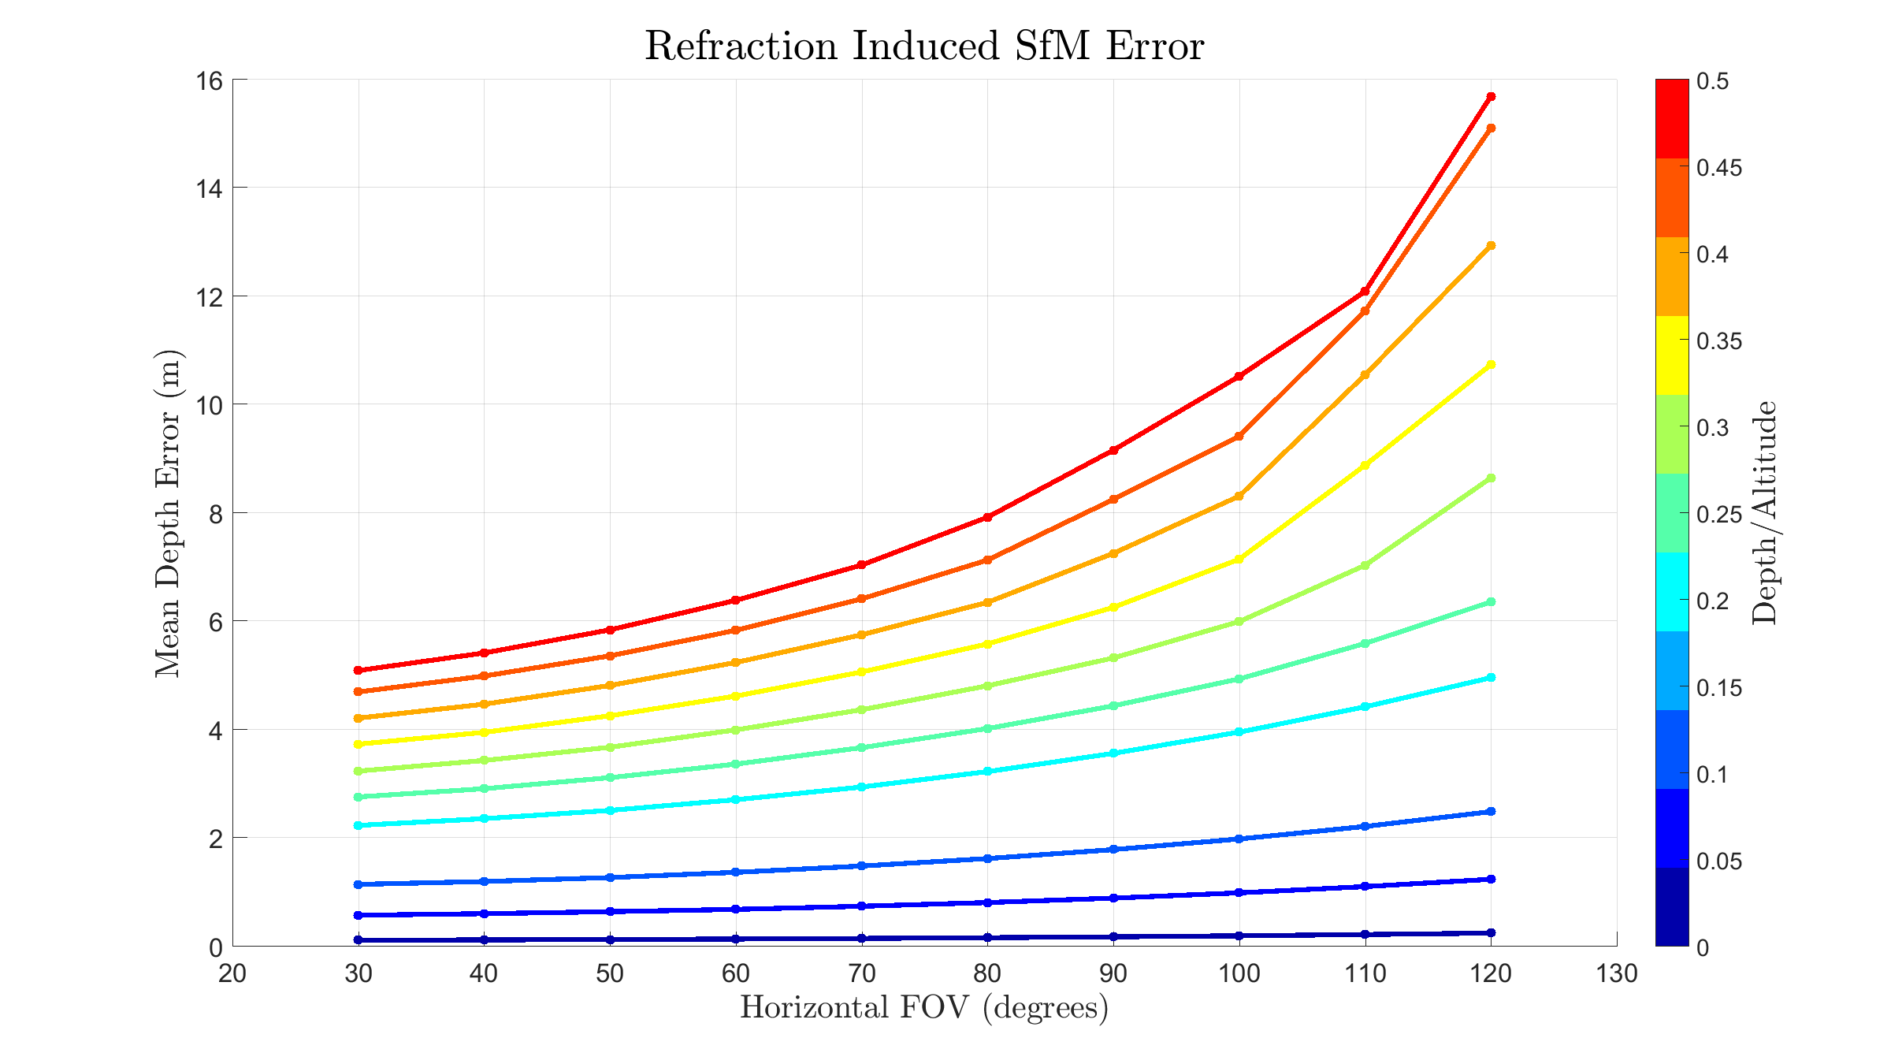
Bathymetry Results
Less Error when:
Narrower FOV
Shallower depths

Slide 31
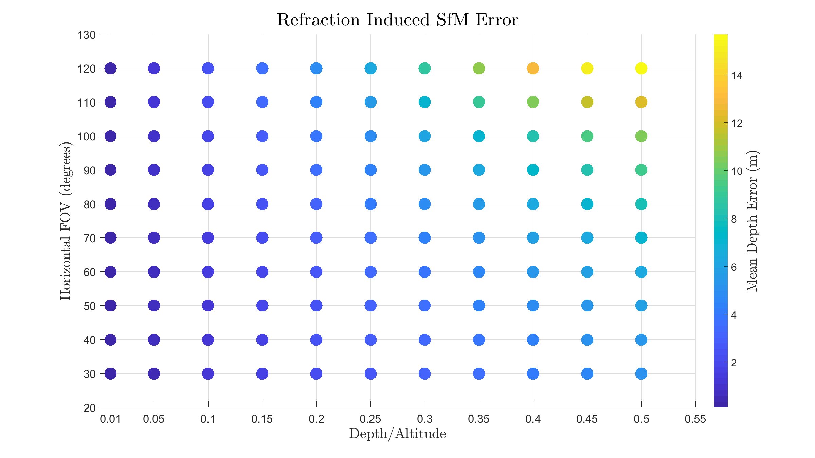
Narrower FOV + Shallower Depth = Less Error
Caveats:
No Waves
Flat Seafloor Bottom
Great Seafloor Texture
No uncertainty in Camera EO
No nonlinear lens distortion

Slide 32
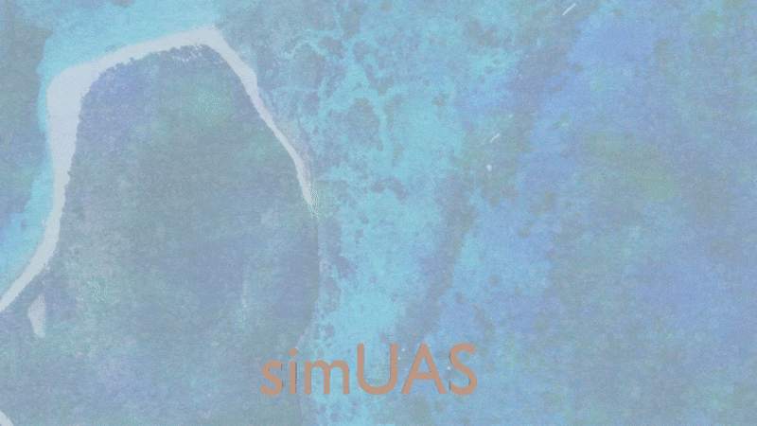
Future Work
Compare simulations to real world data in USVI
Late March
Assess methods to correct refraction induced error
More realistic simulations
Add water waves
Add noise to UAS GPS
Vary seafloor texture

Slide 33
Conclusion
simUAS helps quantify SfM errors over a wide range of conditions
Topo Summary
Denser the better
Bathy summary
Narrower FOV is better for bathy

Slide 34
Questions
slocumr@oregonstate.edu

